Slide 1

Workshop #2 – Part 1 John Roberto, Vibrant Faith

Slide 2
John Roberto Vibrant Faith Leadership Team jroberto@lifelongfaith.com www.LifelongFaith.com SeasonsofAdultFaith.com FamiliesattheCenter.com www.VibrantFaith

Slide 3
Program #2. Envisioning Lifelong Faith Formation in Faith Communities
Topic 1: Maturing in Faith
Topic 2: Intergenerational Faith Formation
Topic 3: Family Faith Formation
Topic 4: Life Stage Faith Formation
Topic 5: Developing a Faith Formation Plan
Homework:
Designing a Faith Formation Plan

Slide 4
Faith Forming Environments
Intergenerational
Family
Peers
Life Stage

Slide 5
Lifelong Faith Formation
Intergenerational
Children
Teens / Youth
Young Adults
Midlife Adults
Mature Adults
Older Adults
Family

Slide 6
Life Stage Faith Formation
Life Stages
Life Stages Design
Young Children & Families
Older Children & Families
Young Adolescents & Families
Older Adolescents & Families
Young Adults (20s-30s)
Midlife Adults (40s-mid 50s)
Mature Adults (mid 50s–75)
Older Adults (75+)
Nurturing faith growth in the intergenerational faith community?
Nurturing faith growth at home?
Nurturing faith growth in an age group / peer group setting?

Slide 7
Lifelong Faith Formation Plan

Slide 8

Maturing in Faith

Slide 9
Focus on Maturing in Faith: Toward What Ends Are We Working
Youth
Midlife Adults
Children
Young Adults
Mature Adults
Older Adults

Slide 10
Maturing in Faith
We need to focus faith formation on the essential characteristics of lifelong growth in Christian faith and discipleship. These characteristics would incorporate knowing and believing, relating and belonging, practicing and living. With a lifelong vision of maturing faith we could address each characteristic in developmentally-appropriate ways at each stage of life.

Slide 11
Characteristics
Developing and sustaining a personal relationship and commitment to Jesus Christ
Living as a disciple of Jesus Christ and making the Christian faith a way of life
Reading and studying the Bible—its message, meaning, and application to life today
Learning the Christian story and foundational teachings of the Christian faith (Trinity, Jesus, creed, morality and ethics) and integrating its meaning into ones life
Praying—together and by ourselves, and seeking spiritual growth through spiritual disciplines

Slide 12
Characteristics
Living with moral integrity guided by Christian ethics and values
Living the Christian mission in the world—serving those in need, caring for God’s creation, and acting and advocating for justice and peace.
Worshipping God with the community at Sunday worship, ritual celebrations, and the seasons of the church year
Being actively engaged in the life, ministries, and activities of the faith community
Practicing faith in Jesus Christ by using one’s gifts and talents within the Christian community and in the world

Slide 13
A Diversity of Spiritual Religious Identities
Not Spiritual, Not Religious
Unaffiliateds
The Spiritual but Not Religious
Uninvolved
Faith & Engagement – one among many priorities
Occasionals
Faith & Engagement at the Center of Life
Actives

Slide 14
Developing a Faith Formation Plan
Faith Maturing Characteristic | Children | Youth | Young Adults | Adults | Family
 | Intergen-erational | Intergen-erational | Intergen-erational | Intergen-erational | Intergen-erational
1.
 | Family | Family | Family | Family | Family
2.
 | Age Group | Age Group | Age Group | Age Group | Age Group
3.

Slide 15
Multiple Ways to Foster Faith Maturing
Maturing in Faith
Approach
Approach
Approach
Approach
Approach

Slide 16

Forming Faith: Intergenerational
Utilize intergenerational events
Infuse intergenerational into existing programs
Connect the generations through new intergenerational new programs & experiences

Slide 17
Intergenerational Approaches
Utilizing the intergenerational events and experiences of church life (community life events, worship and the lectionary, seasons of the year, service and mission projects, prayer and spiritual formation) as a primary “content” in faith formation.
Infusing intergenerational experiences and relationships into existing programs and activities.
Connecting the generations through new intergenerational programs and experiences that bring together all of the generations for learning, celebrating, praying, reading the Bible, serving and working for justice, and worshipping.

Slide 18
Worship & All Ages Faith Formation
Worship Theme
Readings
Homily/Sermon
Family
Youth
Adults
Learn
Read
Podcast
Watch / Listen
Scripture
Prayer
Live

Slide 19
Utilizing Events
1 - Preparation: knowledge & practices for participating fully
2 - Guided Participation: in the events of church life & the Christian Faith
3- Reflection: on the experience and living its meaning in daily life

Slide 20
Infusing Intergenerationality
Infusing intergenerational experiences and relationships into existing programs and activities, such as bringing mature adults into children and youth programs for interviews, storytelling, and mentoring; and transforming age-group programs (vacation Bible school, service projects) into intergenerational experiences.
Worship
Service projects and mission trips
Age group learning programs
Social / community program
Sacramental preparation

Slide 21
Connecting through New Programs
Intergenerational Service
Intergenerational Mission Trips
Churchwide Service Day
Intergenerational Monthly Project
Intergenerational Service Nights
Intergenerational Service Projects
Intergenerational Learning
Weekly or Bi-Weekly
Monthly
Seasonal
Small Group & Large Group

Slide 22
Learning
Incorporating Intergenerational Learning in Church Life
Age Group Programming
Sacramental and Milestone Celebrations
Church Year Feasts & Seasons
Vacation Bible School
Mission Trips & Service Projects
Retreat and Camp Experiences

Slide 23
Intergenerational Learning
Part 1. Meal, Community Building, Prayer
Part 2. GATHER: All Ages Learning
Part 3. GROW: In-Depth Learning Experience
Formats: Whole Group, Age Group, or Activity Center
Part 4. GO FORTH:
Sharing Learning Experiences
Home Application
Closing Prayer

Slide 24
Intergenerational Faith Formation
Creed
Sacraments
Morality
Bible
Justice
Prayer
Christian Practices
Engaging all ages and generations together in informing and forming disciples of all ages in Christian identity.
Intergenerational Learning
Weekly, Bi-Weekly, and Monthly Models
Small Group & Large Group Models

Slide 25
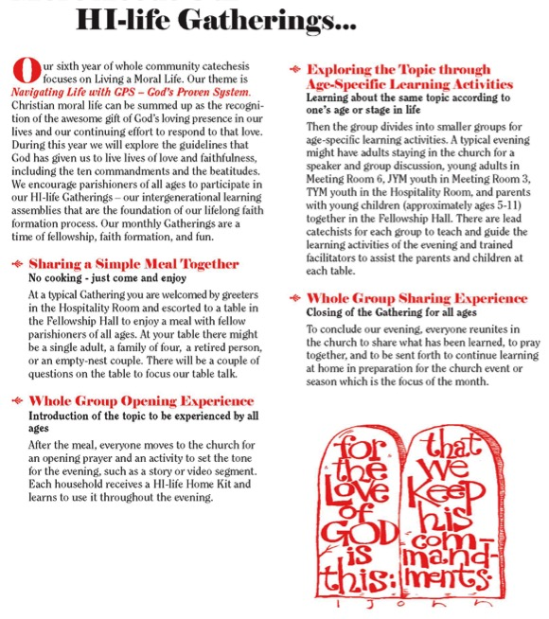

Slide 26
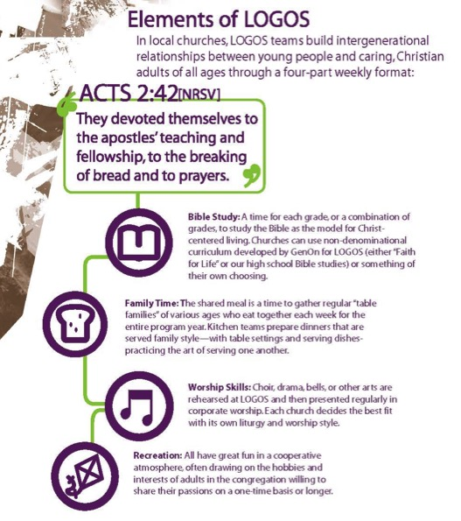
Elements of LOGOS
Bible Study
Family Time
Worship Skills
Recreation
GenOn Ministries
www.genonministries.org

Slide 27

Intergenerational Learning
A flexible, relaxed arrival time with drinks and snacks
Creative exploration of a Bible story/theme through creative experiences for people of different learning styles and of all ages. Children and adults are not separated and are encouraged to explore the story/theme together
A short but explicit time of worship with story, music and prayers that builds on the creative exploration.
A generous welcome and hospitality is expressed through a delicious home-cooked, sit-down meal with others

Slide 28
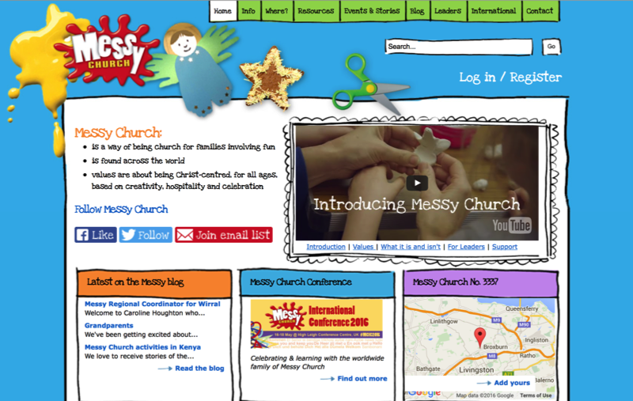
www.messychurch.org.uk

Slide 29
Application
What are the strengths in your congregation?
What are the areas that need improvement or attention in your congregation?
What are the areas where new initiatives need to be created?
Develop ideas for improving current activities and for creating new initiatives for strengthening the intergenerational faith forming power of your congregation.
How can you utilize the intergenerational events and experiences of church life as a primary “content” in faith formation?
How can you infuse intergenerational experiences and relationships into existing programs and activities?
How can you connect the generations through new intergenerational programs and experiences?

Slide 30
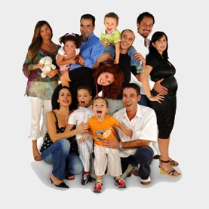
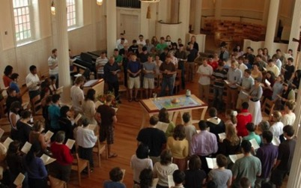
Forming Faith: Family
Primary Influence on transmission of religious faith and practice: Parents & Family
Day-to-day religious practices of the family and the ways parents model their faith and share it in conversation, collaboration, and exposure to outside religious opportunities
Secondary Influence: The Congregation and Significant Adults

Slide 31
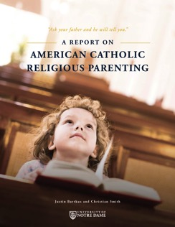
What Makes a Difference?
The primary mechanisms by which Catholic identity becomes rooted in children’s lives are not Catholic schooling or sacramental preparation, but rather the day-to-day religious practices of the family and the ways parents model their faith and share it in conversation, collaboration, and exposure to outside religious opportunities.
(Burtkus and Smith)

Slide 32
One of the most basic suggestions of our findings is that young adults arrive at a sense of their fundamental identity and worldview not by weighing all possible intellectual arguments for and against a proposed way of life, but rather by roughly adopting the worldview of those mentors who left the deepest impression upon them—and who loved them and cared for them the most. It should come as no surprise, then, that the emergence of the new generation of dedicated young Catholics will rise and fall with the choices of their parents.
(American Catholic Religious Parenting, Burtkus and Smith)

Slide 33
Practices that Make a Difference
Reading the Bible as a family and encouraging young people to read the Bible regularly
Praying together as a family and encouraging young people to pray personally
Serving people in need as a family and supporting service activities by young people
Participating regularly in Sunday worship as a family
Being involved in a faith community and serving in church as a family and as young people
Eating together as a family
Celebrating rituals and holidays at home
Having family conversations
Talking about faith, religious issues, and questions and doubts
Ritualizing important family moments and milestone experiences
Celebrating holidays and church year seasons at home
Providing moral instruction

Slide 34
Parental Influence
Parent Role
Sponsor of the Faith point of access between church home
Gatekeeper of the Faith control over how much and what sorts of religious content their children encounter
Interpreter of the Faith meaningful embodiment of the Christian faith in the lives of children

Slide 35
Comprehensive Family Plan Children/Teens + Parents + Grandparents
Family Faith at Home
Family Engagement in the Intergenerational Faith Community
Family Life & Parent Formation
Three Elements of a Family Plan

Slide 36
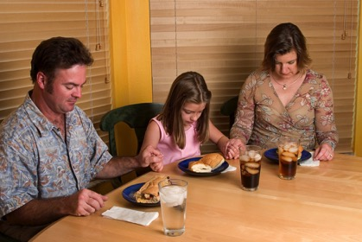
#1. Faith Practices @ Home
Seasons of the year
Rituals and milestones
Learning the tradition
Prayer and spiritual formation
Reading the Bible
Service, justice, care for creation
Young Children
Older Children
Young Adolescents
Older Adolescents

Slide 37
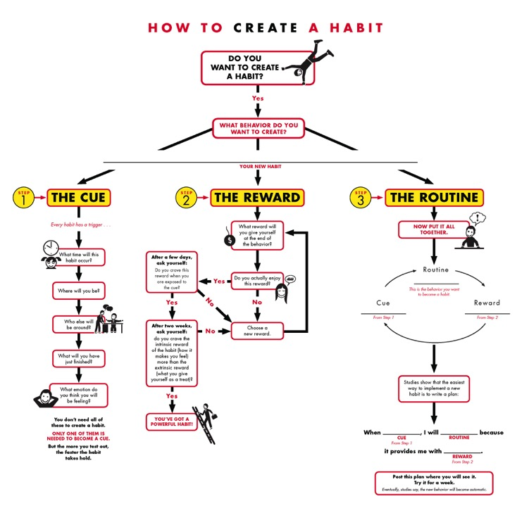

Slide 38
How to Create a Habit
1 The Cue
3 The Routine
2 The Reward
When _(cue)_, I will _(routine)_ because it provides me with __(reward)__.

Slide 39
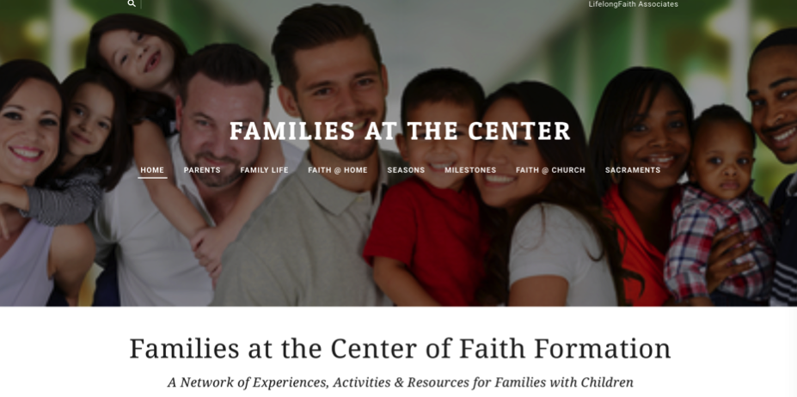

Slide 40
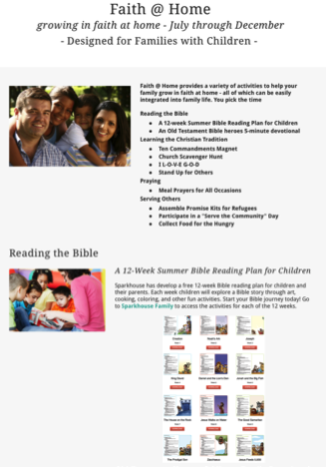
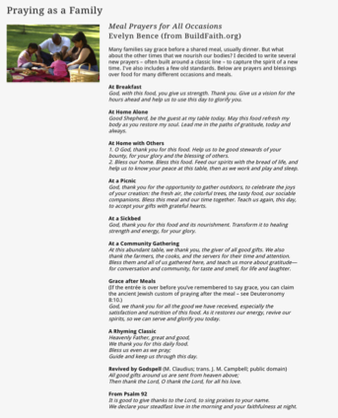
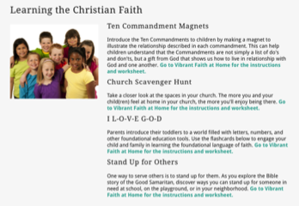
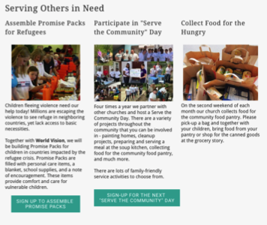
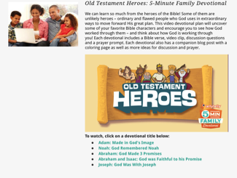

Slide 41
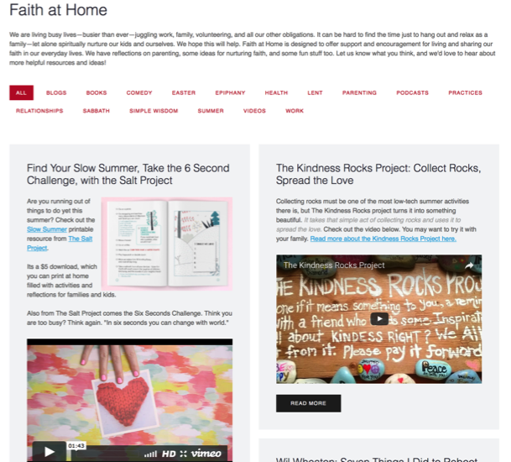

Slide 42
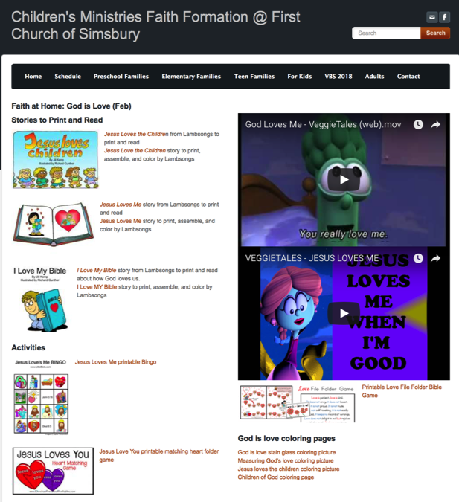

Slide 43

#2. Milestones throughout Life
Ritual and blessing
Home celebration/blessing
Learning program –
Symbol
Supporting continued growth

Slide 44
Milestones
Birth / Baptism
Baptism anniversaries
First prayers
First Bible stories
Starting school year
Receiving a first Bible
First Communion
Confirmation
Graduation
Church ritual/blessing
Home celebration/blessing
Learning program – at church or home
Symbol
Supporting continued growth

Slide 45
Forming Faith through Milestones
a ritual celebration or a blessing marking the milestone with the whole church community
a home ritual celebration or blessing marking the milestone
a learning program, often for the whole family or intergenerational, that prepares the individual and the whole family for the milestone and for faith practice at home
a tangible, visible reminder or symbol of the occasion being marked
resources to support continuing faith growth and practice after the milestone

Slide 46
Forming Faith through Milestones
Preparing
Experiencing
Living
How will you sustain/extend the event?
How will you design the event?
What types of experiences, programming, activities, and resources will you develop to prepare people for the event?
How will you engage age groups, families, and the faith community?
What types of experiences, programs, activities, and resources will you offer people?

Slide 47
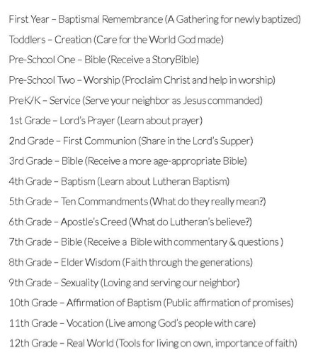

Forming Faith through Milestones

Slide 48
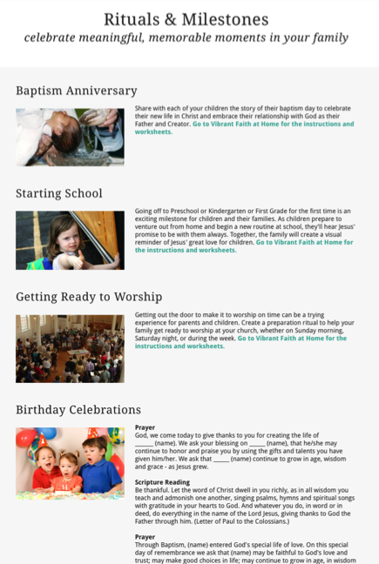

Slide 49
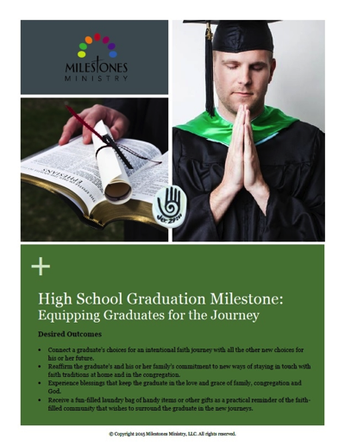
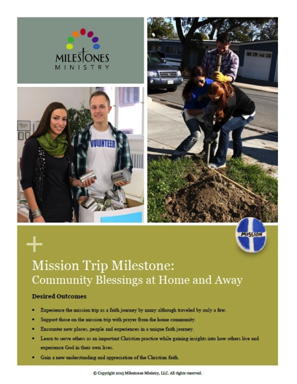
Forming Faith through Milestones

Slide 50
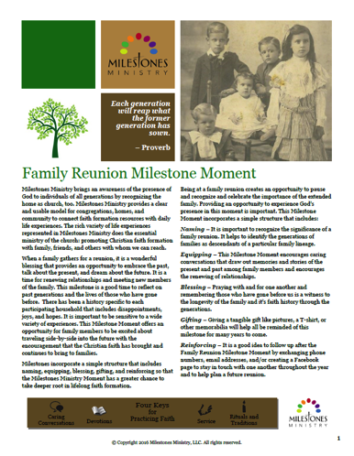
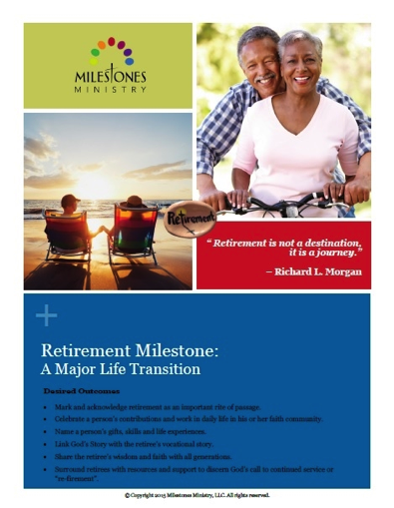
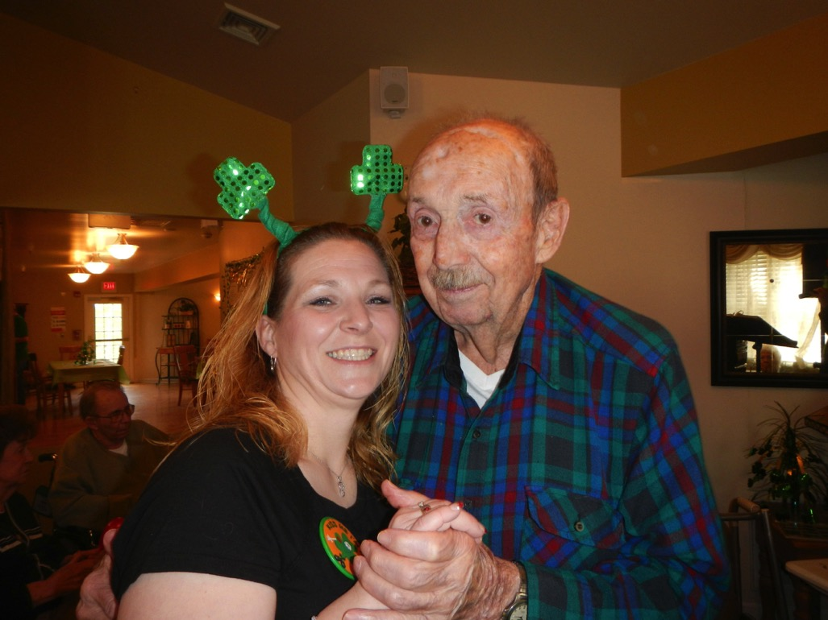
Forming Faith through Milestones

Slide 51
#3. Celebrating Seasons
Calendar Year
Church Year
New Year’s Eve and Day
Martin Luther King Jr. Day
Valentine’s Day
St. Patrick’s Day
Earth Day
Mother’s Day
Memorial Day
Father’s Day
July 4 – Independence Day
Labor Day
Start of School
Halloween
Thanksgiving
Advent
Christmas
Epiphany
Ash Wednesday
Lent
Holy Week
Easter
Pentecost
St. Francis Day–Blessing the Animals (October 4)
All Saints and Souls (Nov 1-2)

Slide 52
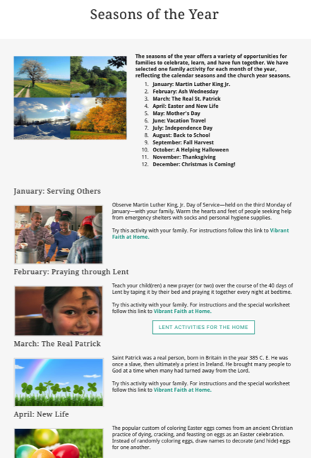

Slide 53
Integrate Online & Gathered 40-Day Lent Curriculum
Church ➔ | Daily & Home | ⬅ Online
Ash Wednesday Lenten Sunday liturgies Stations of the Cross Lenten prayer Lenten retreat Lenten service Lenten soup suppers | Fasting Praying Service/Almsgiving Lectionary reflection Family Lenten activities | Lenten learning resources Lenten calendar Daily Lenten prayer Weekly table prayer Video resources Online retreat experience

Slide 54
Example: Earth Day
Community | Church | Home
Community cleanup Planting a community garden All ages workshop on caring for creation Story time at the library on environmental awareness | Ecumenical prayer service Intergenerational program on theology of caring for creation Church audit Global project for whole community | Recycling activities Planting a family garden Meal time creation prayer Daily Bible verses for April Children’s activities Storybooks and videos Home audit

Slide 55
#4. Encountering God in the Bible
Scripture in Sunday Worship
Lectionary
Sermon Series
Exploring the Bible—Family or Intergenerational Programs
A Tour of the Old Testament
A Tour of the Gospels
Walking with Jesus
Journeys of Paul

Slide 56
Encountering God in the Bible
Scripture in Sunday Worship
Intergenerational & Home Faith Formation
September: 24th Sunday in Ordinary Time
October: 28th Sunday in Ordinary Time
November: 32nd Sunday in Ordinary Time
December: 2nd Sunday of Advent
January: Baptism of the Lord Sunday
February: 1st Sunday of Lent
March: Palm Sunday
April: 4th Sunday of Easter
May: Holy Trinity Sunday

Slide 57
Extend the Event
Church Event or Program
At Home & Daily Life

Slide 58
Practical Strategies
Develop a family faith formation website.
Seasonal family festivals and gatherings.
Connect to Sunday worship.
Schedule a yearlong plan for milestones.
Make faith practices a seasonal focus.
Create family immersion experiences.
Develop a monthly seasonal event.

Slide 59
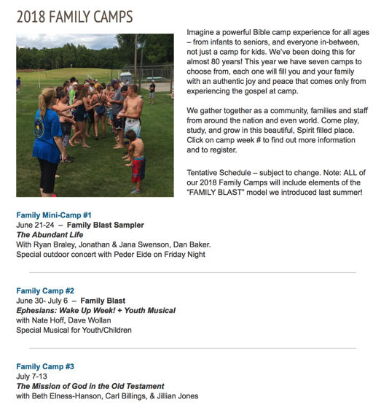

Family Camp

Slide 60
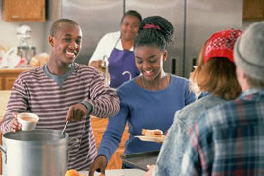
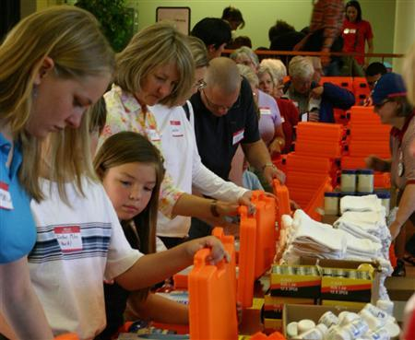
Family Service

Slide 61
#5. Equipping Parents
Equipping parents and grandparents with the knowledge and skills necessary for faith-forming: how to transmit faith and values to their young people, how to become a Christian role model, and how to build a community of faith at home that nurtures faith growth in the young.

Slide 62
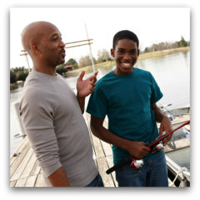

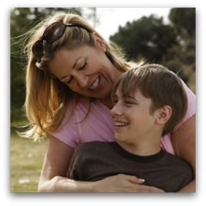


Developing a Strong Family Life Developmental Relationships – Search Institute
Express Care
Challenge Growth
Provide Support
Share Power
Expand Possibilities

Slide 63
What Makes a Difference
Parents participated in mission trips.
Parents participated in service projects.
Parents frequently shared Christ with unbelievers.
Parents personally read the Bible several times a week or more.
Parents encouraged their teen to serve in the church.
Parents typically asked for forgiveness when they messed up.
Parents encouraged their children’s unique talents and interests.
Parents attended churches that emphasized what the Bible says.
Parents taught their children to tithe.

Slide 64
Developing Strong Family Life
Family Life Programming
Communicating effectively
Establishing family routines: family meals, shared activities, daily commitments
Celebrating meaningful traditions and rituals
Discussing tough topics
Making decisions and solving problems as a family
Learning how to build strong relationships and express care for each other
Developing the strengths & potential of children & youth
Supporting each other: encouraging and praising, giving feedback, standing up for each other
Treating each with respect and dignity

Slide 65
Empowering Parents
Competencies
Expressing care, love, affection, and support for children
Balancing time and commitments, managing stress
Practicing healthy relationships
Disciplining children and learning discipline practices
Creating a warm, caring supportive family.
Set boundaries and high expectations for children
Managing technology and media use
Challenging children to grow and continuously improve
Providing support to help children complete tasks and achieve goals
Sharing power with children so that there voice is heard and they share in making decisions.
Expanding possibilities and connecting children to opportunities for growth
Developing emotional communication skills
Developing positive parent-child interaction skills
Learning to respond consistently to their child

Slide 66
Three Parental Faith Roles
Parent Role
Sponsor of the Faith point of access between church home
Gatekeeper of the Faith control over how much and what sorts of religious content their children encounter
Interpreter of the Faith meaningful embodiment of the Christian faith in the lives of children

Slide 67
Empowering Parents
Key Content
Faith Forming Skills & Practices
Parental Faith Formation
Knowledge & Skills for Parenting

Slide 68
Parent Programming
Parent website
Parent programs
Progression of parent workshops, webinars, or courses through the life cycle
Incorporate parent formation and education into congregational events that already engage parents
Provide targeted programs of theological and biblical formation
Add a parent-only component to family-intergenerational learning programs
Add a parallel parent experience to the existing children/teen program
Add a parent component to vacation Bible school in the evenings or online.
Provide online faith formation for parents
Laboratory experiences
Parent mentors
Life cycle or affinity groups for parents

Slide 69
Suggestions for Programming
Address diverse spiritual-religious identities of parents.
Have parents practice new skills with their own children during program sessions.
Design programs that engage parents in the learning experience.
Use a variety of environments and methods to engage all parents, anytime and anywhere.
Use online platforms and digitally enabled strategies.
Give parents a plan.

Slide 70
Application
Analyze the ways that your congregation nurtures the faith of the family and equips parents.
What are the strengths in your congregation?
What are the areas that need improvement or attention in your congregation?
What are the areas where new initiatives need to be created?
Develop ideas for improving the your congregation’s response to families and parents using the ideas contained in the five strategies. Build on your current strengths and identify new initiatives that you want to implement. Review the strategies before you begin.
#1. Nurturing Family Faith Practices
#2. Celebrating Milestones
#3. Celebrating the Seasons of the Year
#4. Reading the Bible through the Year
#5. Equipping Parents and Grandparents as Faith Formers

