Slide 1

Workshop #2 – Part 2
John Roberto, Vibrant Faith

Slide 2

Personalizing Faith Formation

Slide 3
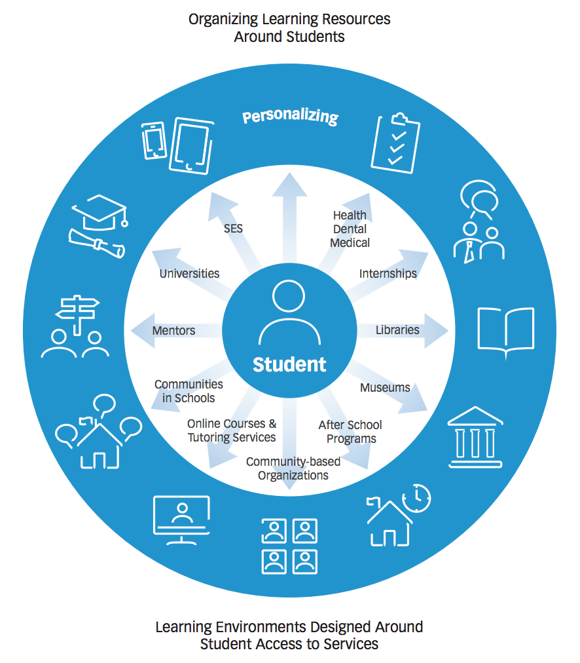
Personalizing Learning
Personalized learning is tailoring learning for each student’s strengths, needs and interests— including enabling student voice and choice in what, how, when and where they learn— to provide flexibility and supports to ensure mastery of the highest standards possible.

Slide 4
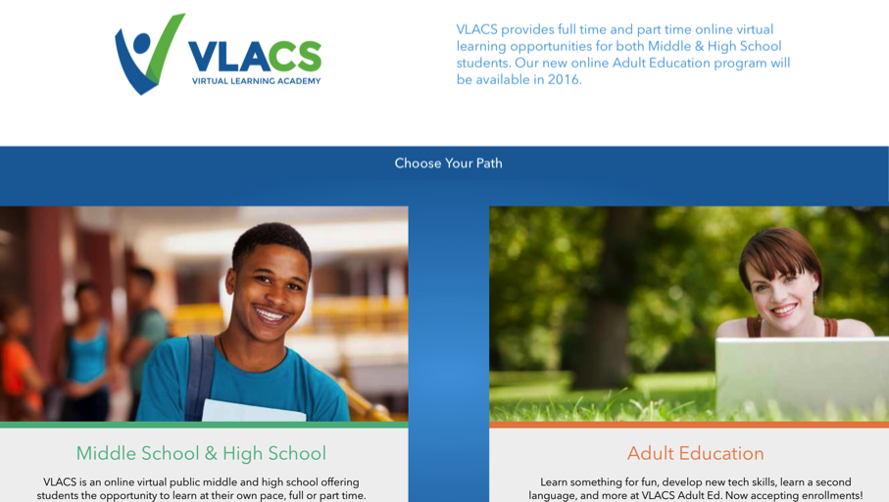
Virtual Learning Academy

Slide 5
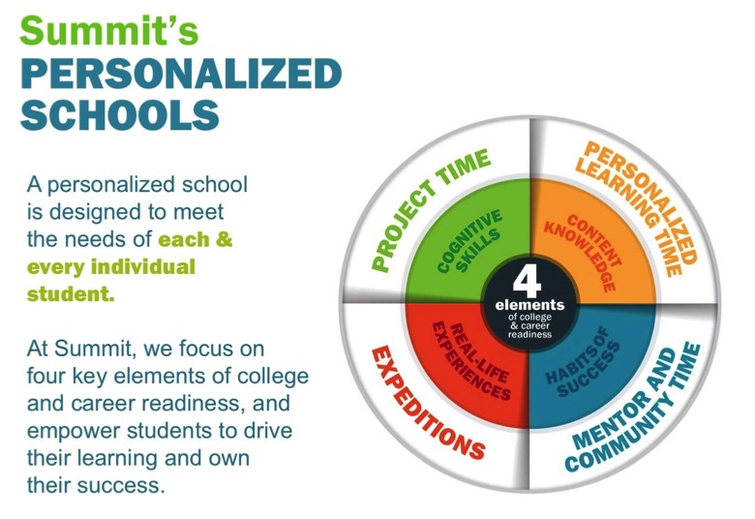
Summit Schools

Slide 6
Two Ways to Approach Personalizing
Approach One: Personalize the Pathway for People
Develop pathways of faith maturing
Develop playlists of content and experiences tailored to the pathways
Upload playlists to a digital platform
Approach Two: Personalize the Offerings
Offer a variety of content, experiences, and activities tailored to different spiritual-religious identities and the life stage needs of people
Getting Started ---- Growing ---- Going Deeper
Format the content tailored to different spiritual-religious identities
Develop a digital platform with content to address the needs

Slide 7
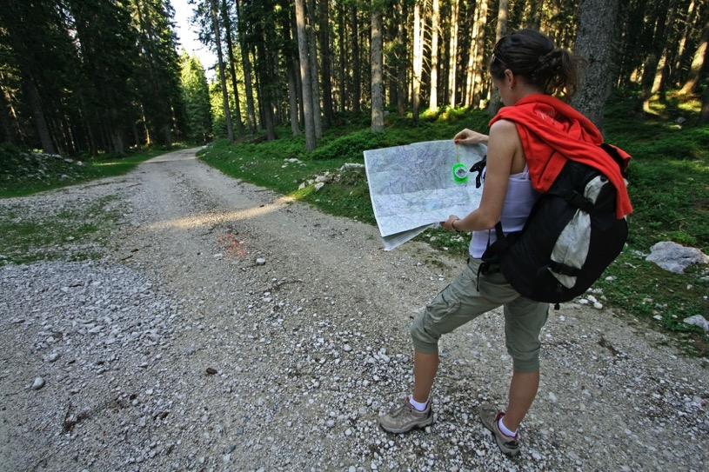
Pathways of Faith Growth

Slide 8
A Pathways Model
A Pathway is a process for helping people discern where they are in their faith journey and to chart a path for faith growth—to get from where they are to a closer relationship with Jesus and a deeper practice of the Christian faith.
A Pathway is life-centered, reaching into every area of a person’s life.
A Pathway is holistic incorporating the whole person: head, heart, and hands.
A Pathway focuses on faith maturing.

Slide 9
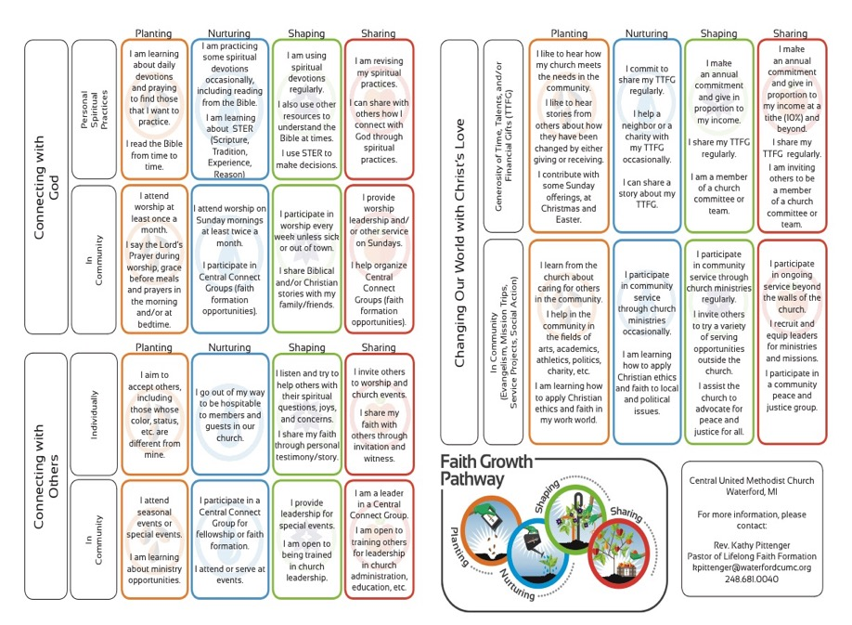

Slide 10
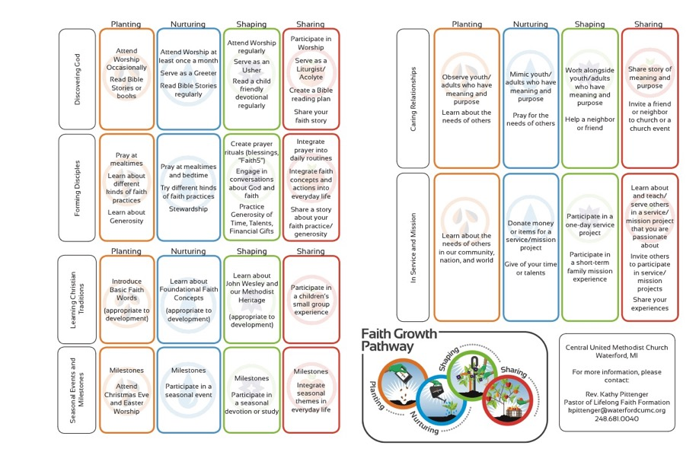

Slide 11
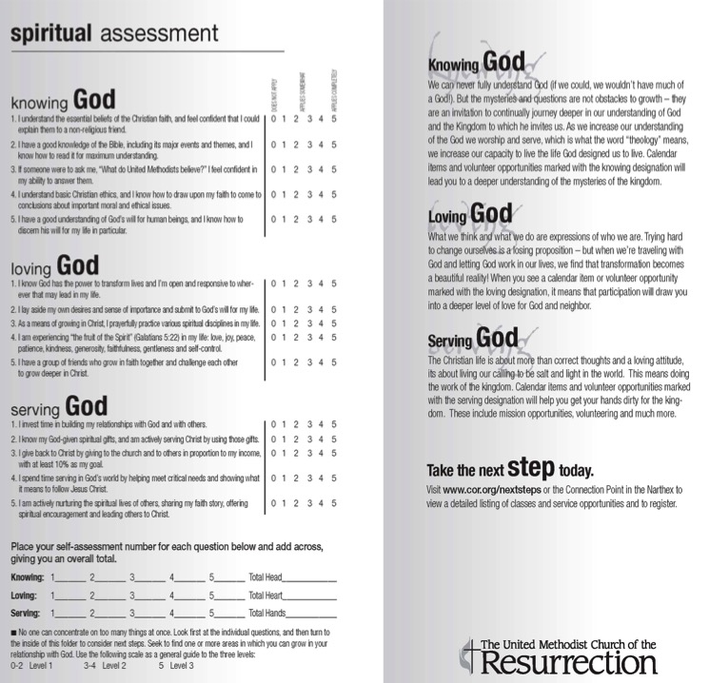

Slide 12
Diverse Spiritual-Religious Needs
Not Spiritual, Not Religious
Unaffiliateds
The
Spiritual but Not Religious
Uninvolved
Faith & Engagement – one among many priorities
Occasionals
Faith & Engagement at the Center of Life
Actives

Slide 13
Personalized Pathways of Faith Growth
Pathways
PATHWAY
Variety of Experiences & Activities
Occasional
Variety of Experiences & Activities
Uninvolved
Unaffiliated
Variety of Experiences & Activities
Vibrant
PLAYLIST

Slide 14
Personalized Pathways of Faith Growth
Characteristic
Inquiring
Playlist of Experiences & Activities
Getting
Started
Playlist of Experiences & Activities
Growing
Playlist of Experiences & Activities
Going
Deeper
Playlist of Experiences & Activities

Slide 15
Designing a Pathways Model
Identify a target audience(s)
Describe their life stage & religious-spiritual characteristics.
Identify how/where you will use the Pathways model
    Sacraments/milestones
    RCIA, evangelization, and new member processes
    Gathered faith formation programming & meetings
    Small groups: affinity groups, interest groups, Bible study groups
    On-ramps where people might start the discipleship journey
Develop the characteristics of faith growth for the Pathways
Develop a ‘discernment continuum” that gives people a way to reflect on their current growth

Slide 16
Designing Steps 1 & 2
Target Audience & Description
Surveys
Focus Groups
Interviews
Research Reviews
Sample Themes – Mature Adults
Dealing with retirement
Making life plans, finances, health
Becoming a grandparent
Making a difference in the community and world
Incorporating family changes and transitions
New ways of living and relating as a married couple
Caring for aging parents
Taking time to read the Bible and learn more about my faith
Growing spiritually and exploring spirituality for the 2nd half of life
Connecting with people my age; talking about things that matter to us
Dealing with loss

Slide 17
Designing Step 3 - How & Where
Identify how/where you will use the Pathways model
Sacraments/milestones: Marriage, Baptism, First Communion, Confirmation, beginning church faith formation, etc.
RCIA, evangelization, and new member processes
Gathered faith formation events and programming
Parenting meetings
Small groups: affinity groups, interest groups, Bible study groups,
On-ramps where people in your church might start the discipleship journey

Slide 18
Designing Step 4 – Characteristics
Develop the characteristics of faith growth you want to use in your Pathways model. For example:
Option 1. Use characteristics of faith growth specific to the life stage (such as family faith practices) or the content of the event (such as preparing for confirmation)
Option 2. Use characteristics of maturing faith

Slide 19
Key Characteristics of Maturing Faith
Relationships with Jesus Christ
Living the Christian way of life - discipleship
Living with moral integrity
Learning and articulating the teachings of the Christian tradition
Praying and seeking spiritual growth
Studying and reading the Bible
Engaging in service and mission to the world
Worshipping with the community

Slide 21
Designing Step 5 – Discernment
Develop a ‘discernment continuum” that gives people a way to reflect on their current growth
Inquiring--Getting Started--Making Progress--Going Deeper
“How true each statement is for you?”
  1 = Rarely true of me
  2 = Sometimes true of me,
  3 = Occasionally true of me
  4 = Almost always true of me
  5 = Always true of me.

Slide 22
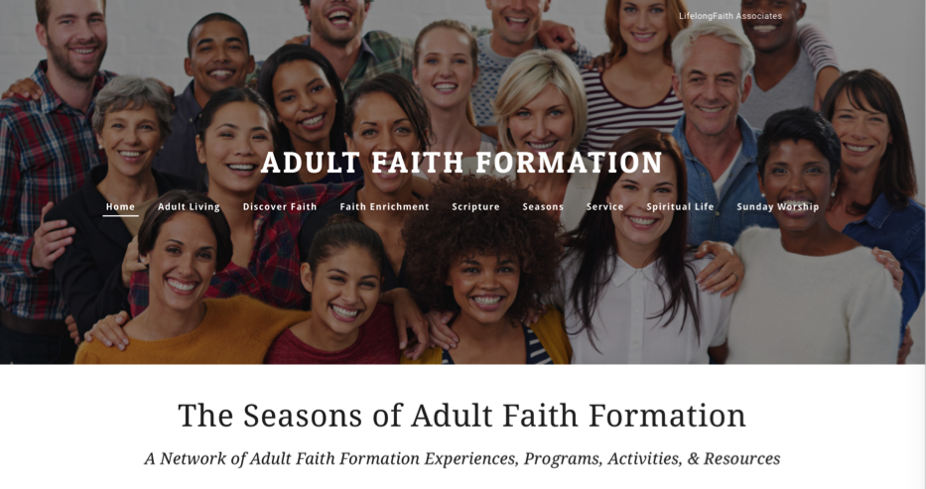
Approach #2.
Personalize the Offerings

Slide 23
Personalize the Offerings
Playlists Tailored to Different Faith Needs
Playlist:
Reading & Studying the Bible
Getting Started
  Participate in the “Welcome to the Bible” program at church
  Watch the video programs on how to read the Bible
  Watch the video program with an overview of the Old Testament and New Testament
  Use the Guide to select a Study Bible and find the Bible online
  Participate in the 30-Day Bible Experience: Reading one Gospel (Matthew, Mark, or Luke)
Growing
  Develop a daily plan for reading the Bible
  Participate in the lectio divina reflection group after Sunday worship
  Learn how to pray with the Bible
  Join a Bible study group (church, home, coffee shop, online)
Going Deeper
  Read the Bible in 365 days
  Develop a personal Bible study plan
  Take an online course: Hebrew Scriptures, Gospels, Letters of Paul
  Study and pray the Psalms as a spiritual practice

Slide 24
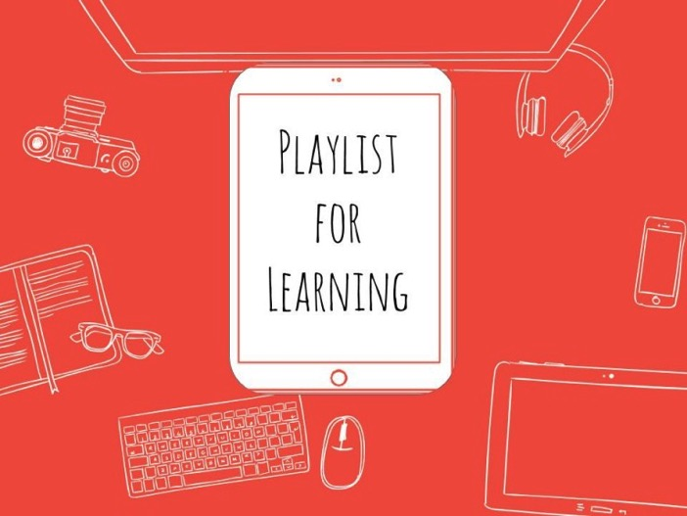
Playlists for Faith Formation

Slide 25
Faith Formation Playlists
A faith formation playlist is a curated group of digital (online, video, audio, print) and gathered (church, home, small groups, etc.) faith forming experiences and resources that are tailored to the specific faith growth needs of people around a particular characteristic of faith maturing or theme/topic.
Playlists are developed for each “stage” on the discernment continuum, such as Inquiring, Getting Started, Growing, Going Deeper.
Each playlist provides a variety of ways for people to learn and grow in faith.

Slide 26
Curating Playlists
Books
Audio / Podcasts
Video and movies
Apps and digital programming
Website content and activities
Courses, programs, workshops at church and online
Church life, ministries, and events
Small groups at church, home, community settings
Art, drama, music
Service and action projects, mission trips
Retreats
Field trips
Mentoring

Slide 27
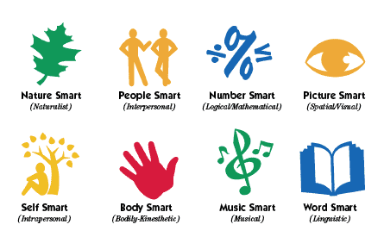
Faith Formation Playlists
Variety of Environments: Self-directed, mentored, at home, in small groups, in large groups, church-wide, in the community, and in the world.
Variety of Ways
to Learn

Slide 28
Playlists of Content & Experiences
If you were to use a Playlist approach to develop the faith of families with young children….
      Getting Started Families (little faith experience)
      Growing Families (somewhat connected to faith community)
      Going Deeper Families (involved and practicing)
  How would you engage the parents?
  How would you engage the children and whole family?

Slide 29
Playlists of Content & Experiences
If you were to use a Playlist approach for first communion…
      Getting Started Children (little to no faith forming experiences)
      Growing Children (some faith forming experiences)
      Going Deeper Children (involved and practicing)
  What would faith formation look like with these three “types” of children?
  What would parent and family faith formation look like?

Slide 30
Playlists of Content & Experiences
If you were to use a Playlist approach for confirmation…
      Getting Started Adolescents (little to no faith forming experiences since childhood)
      Growing Adolescents (some faith forming experiences in childhood)
      Going Deeper Adolescents (involved and practicing)
  What would faith formation look like with these three “types” of adolescents?
  What would parent and family faith formation look like?

Slide 31
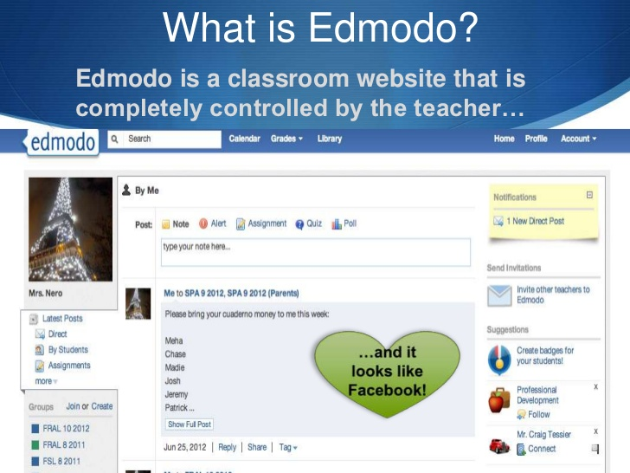

Slide 32

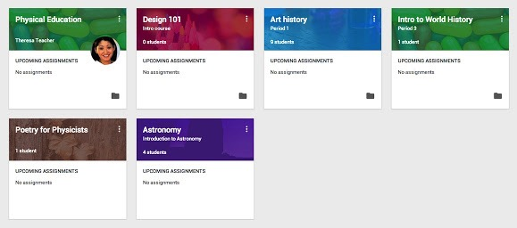
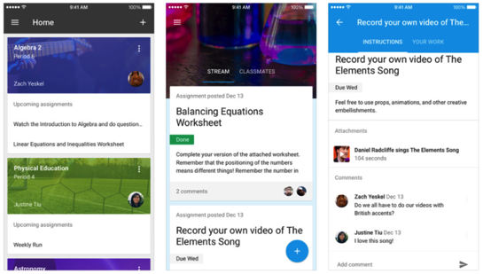

Slide 33

Digital Faith Formation Strategies

Slide 34
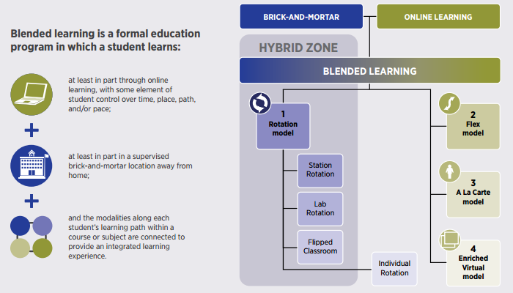
Blended Learning

Slide 35
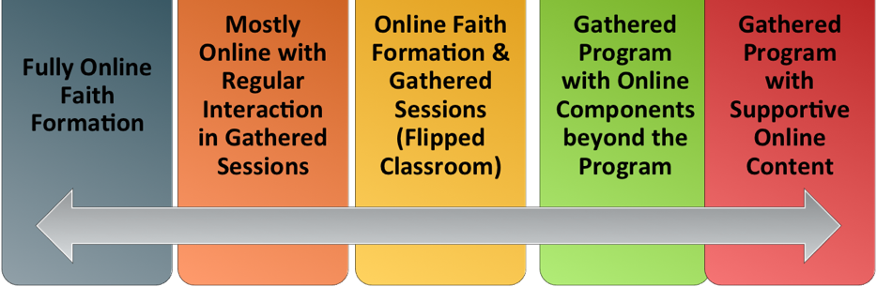
Digitally Enabled & Digitally Connected Faith Formation

Slide 36
Extend the Event
Church or School Event or Program
At Home & Daily Life

Slide 37
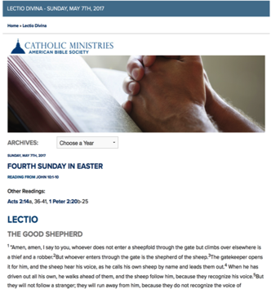
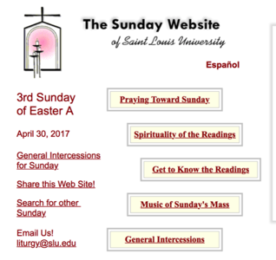
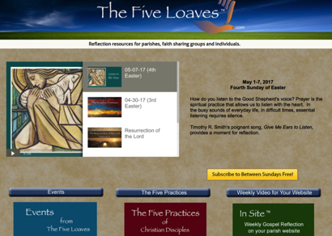

Sunday Worship
Learning
Praying
Reading the Bible: Daily Readings
Living

Slide 38
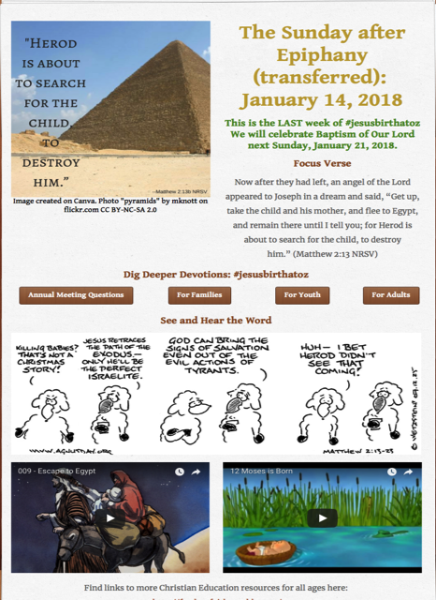
Tri-Saints Lutheran
Hardy, NE

Slide 39
One Event/ Program, Multiple Formats
Multiple Formats
Digital Content to Extend & Provide New Ways to Experience
Social Media
Interaction
Communication
Demonstration
Connection
Gathered
Website
Small Group
Independent
Online
Event/Program

Slide 40
Build on an Event/Experience
Preparing
Experiencing
Living
How will you sustain/extend the event?
How will you design the event?
What types of experiences, programming, activities, and resources will you develop to prepare people for the event?
How will you engage age groups, families, and the faith community?
What types of experiences, programs, activities, and resources will you offer people?

Slide 41
Flip the Model
@ Home / Daily Life
Exploring the Content
- print, audio, video, activities
@ The Program
Applying the Content:
Create – Practice - Perform - Participate

Slide 42
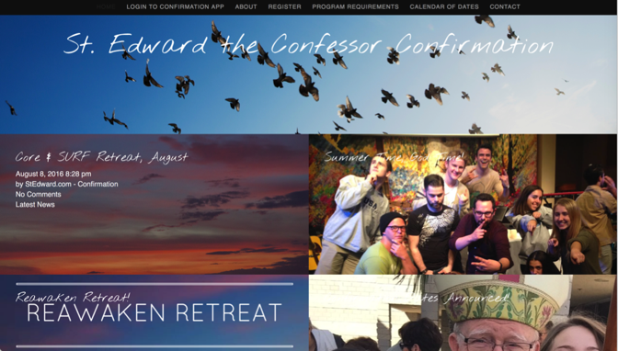
Our Confirmation preparation program has two components: Once a month in-person classes and an online study. The online study is a place for students to develop their faith weekly by completing multi-media lessons which include videos, reading, Saint reflections, multiple-choice questions and online small group discussions. Each small group has their own online space to discuss faith topics, ask questions, and pray for one another. By having both in person classes and an online study we hope to help families learn more about their faith while respecting the many demands for their time.

Slide 43
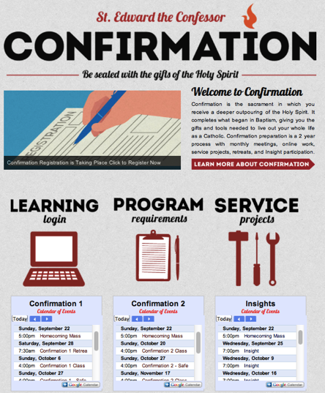
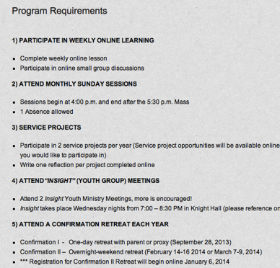
Confirmation

Slide 44
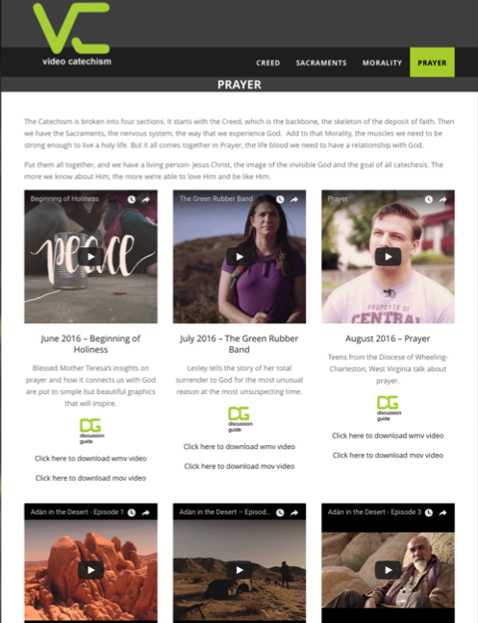

Slide 45
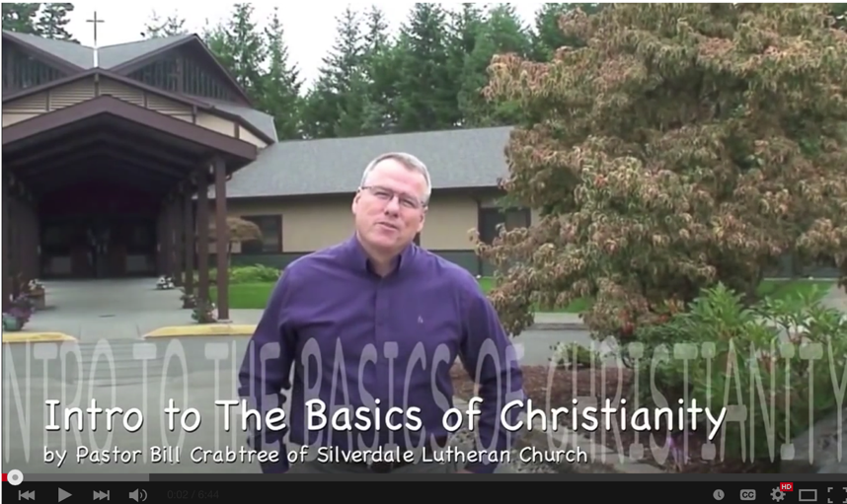
Christian Initiation & New Member Formation

Slide 46
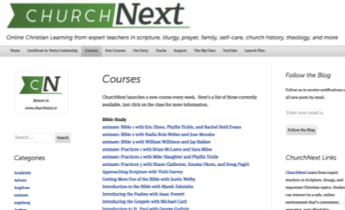

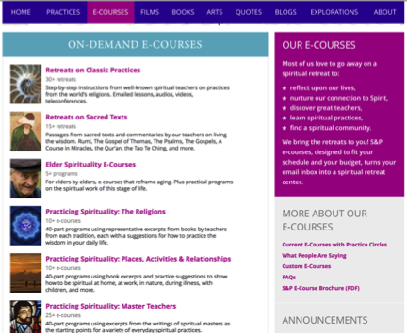
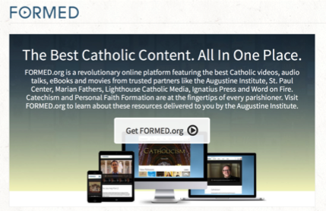
Flip the Model

Slide 47




Flip Christian Initiation

Slide 48
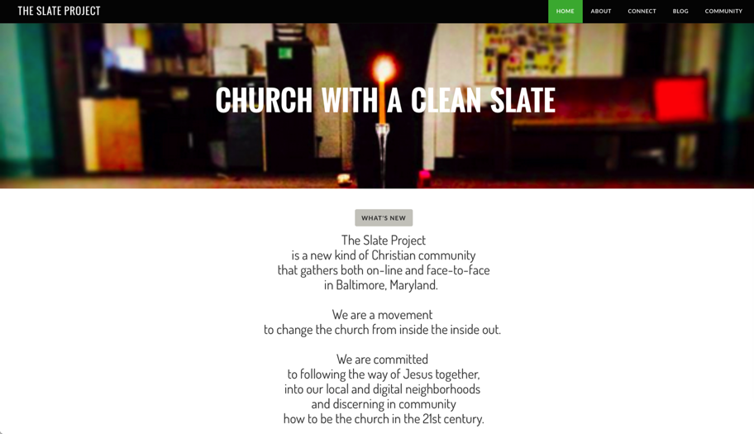
Integrate Online and Gathered

Slide 49
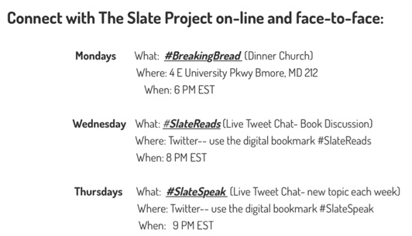
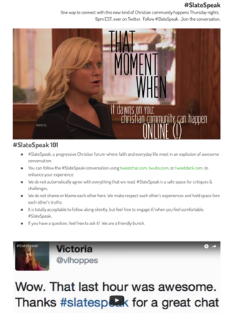
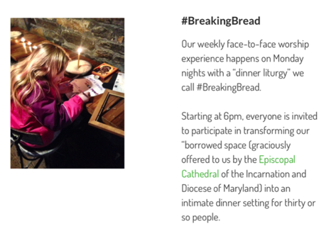
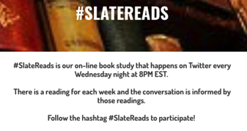

Slide 50
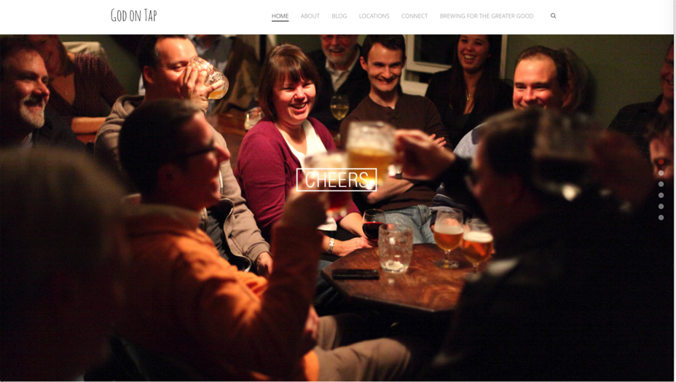
Integrate Online and Gathered

Slide 51
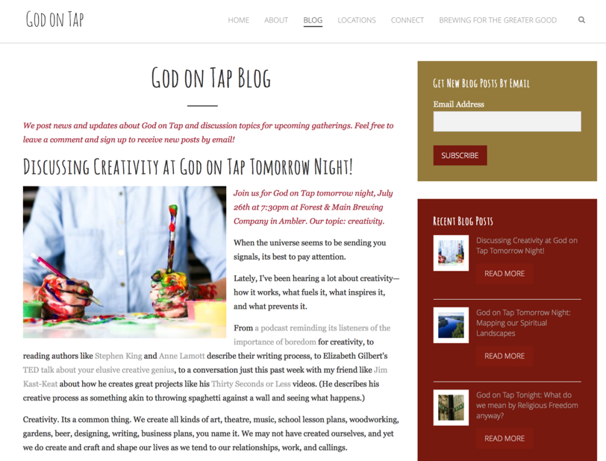

Slide 52
Online 40-Day Lent Curriculum
Church ➔ | Daily & Home | ⬅ Online
Ash Wednesday Lenten Sunday liturgies Stations of the Cross Lenten prayer Lenten retreat Lenten service Lenten soup suppers | Fasting Praying Service/Almsgiving Lectionary reflection Family Lenten activities | Lenten learning resources Lenten calendar Daily Lenten prayer Weekly table prayer Video resources Online retreat experience

Slide 53
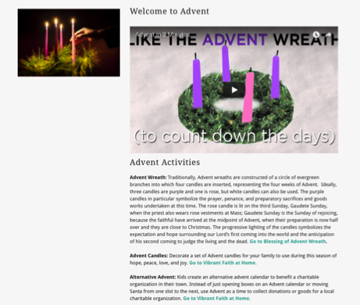
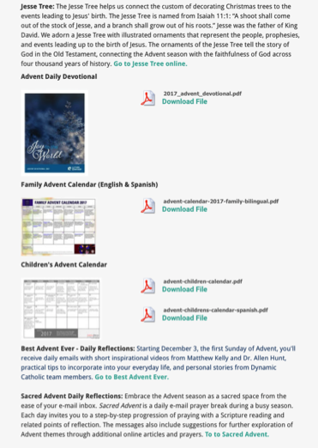
Advent or Lent Online “Curriculum”

Slide 54
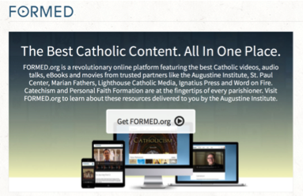
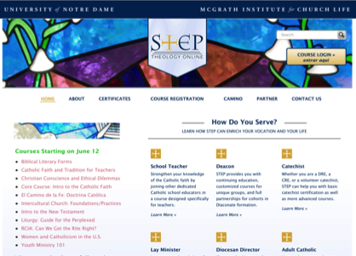

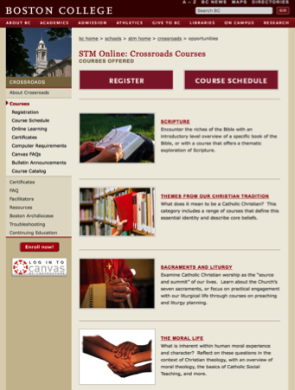
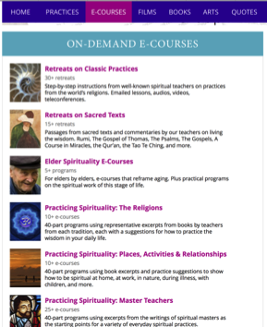
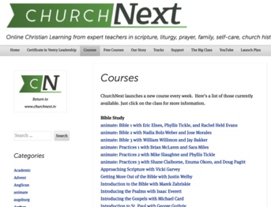
Online Learning

Slide 55
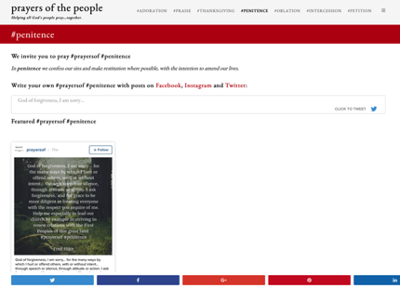
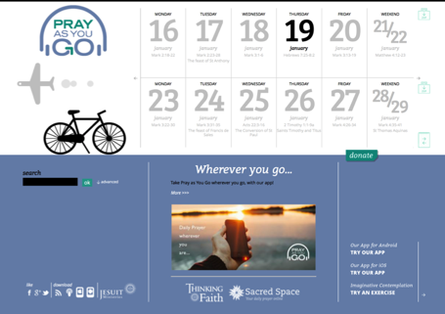
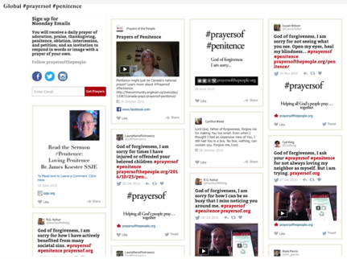
Online Prayer

Slide 56
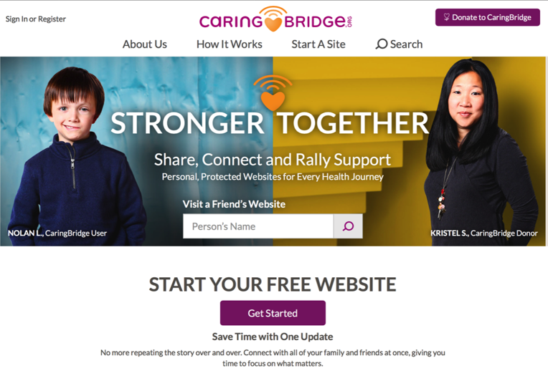
Pastoral Care

Slide 57
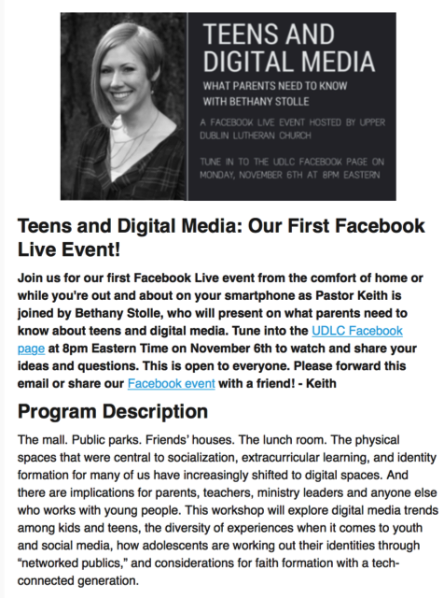
Webinar
Live Presentation
Upper Dublin Lutheran Church

Slide 58

Curating Faith Formation

Slide 59
What is Content Curation
(Beth Kanter)
Content curation is the process of sorting through the vast amounts of content on the web and presenting it in a meaningful and organized way around a specific theme.
The work involves sifting, sorting, arranging, and publishing information.
A content curator picks the best content that is important and relevant to share with their community.
It isn’t unlike what a museum curator does to produce an exhibition: They identify the theme, they provide the context, they decide which paintings to hang on the wall, how they should be annotated, and how they should be displayed for the public.

Slide 60
Curating Religious Content
Research & Organize Resources
Identify Potential Resources for Programming
Evaluate Resources
Select & Connect Resources to programming

Slide 61
Develop Trusted Sources
Blogs
Newsletters Websites
Denominations Curated Websites Religious Organizations
6-8 “Expert” Resource People

Slide 62
Develop a Research Checklist
People: teachers, mentors/guides, guest presenters
Community programs: churches, agencies, organizations,
Educational institutions: colleges, seminaries
Retreat and spiritual life centers, monasteries
Denominational programs, events, websites
Museums
Books (with study guides) & E-books
Apps
Audio podcasts & audio learning programs
Videos & video learning programs
Online courses & online activities
Television shows
Organizational websites
Resource center websites

Slide 63
Develop Evaluation Criteria
Biblical content and interpretation
Theological content and emphasis
Developmental appropriateness
Ethnic-Cultural appropriateness
Inclusive of diversity
Respect for diverse ways of learning
Appearance and visual appeal
Ease-of-Use
Quality of Experience
Applicable: Able to be incorporated into daily and home life

