Slide 1

Workshop #3 – Designing Faith Formation
John Roberto, Vibrant Faith

Slide 2
John Roberto
Vibrant Faith Leadership Team jroberto@lifelongfaith.com www.LifelongFaith.com
SeasonsofAdultFaith.com
FamiliesattheCenter.com www.VibrantFaith

Slide 3
Program #3. Designing Faith Formation
Describe the audience.
Develop creative responses.
Identify potential directions.
Design for the four religious-spiritual identities.
Personalize the process and the faith formation offerings with a variety of content, methods, times, and formats designed to engage all people.
Use digitally enabled and connected strategies to enhance and expand faith formation.
Design a website platform and a social media strategy.
Develop the complete faith formation plan, implementation steps, and timeline.

Slide 4
Developing a Plan
Empathize
Design Prototypes
Test & Evaluation
Generate Ideas
Scale
Year One | Year Two | Year Three

Slide 5
Projects
Parents of children [0-confirmation]
Needs assessment with families / what we offer / digital
Sacramental preparation for Baptism, First Communion and Confirmation, couples preparing for Marriage [questionnaire + respond to people’s needs]
Add parent/grand to confirmation – one-day retreat
Help young people integrate into parish life / roles
Reconfiguring sacramental prep – opportunities for parents (face to face and online) – fit into their lives
Grand Camp (July)
Developing family discipleship groups, parents with children/teens + grandparents, on-the-job training in discipleship, engagement / start with confirmation
Saturday school (children-teens), sacraments, digital during the week
Confirmation – more intergenerational, retreat, online tool, connection,
Evangelization meetings: at church + outreach; involve in church activities

Slide 6
Questions/Concerns/Roadblocks
Developing a registration form that will help us put the family in the session best suited to them
Organizing small groups (family type, mixed groups?) & numbers
Ideas of where to find video clips with parenting suggestions
Change sacramental structure (Confirmation)
Access to digital
How to get people’s attention
How to motivate / engagement
Resistance of parents to being part of program
Parish website + faith formation website
How to use Formed / Using Flocknote
Loss of sense of community
Developing younger leaders
Confirmation: get buy-in from the school
Language barriers / communication

Slide 7
Structuring Programming
Child programs
Parent programs
Family-centered experiences
@ Home activities
    Seasons of the year
    Rituals and milestones
    Learning the tradition
    Prayer and spiritual formation
    Reading the Bible
    Service, justice, care for creation

Slide 8
Examples

Slide 9
Worship & All Ages Faith Formation
Worship Theme
Readings
Homily/Sermon
Family
Youth
Adults
Learn
Read
Podcast
Watch / Listen
Scripture
Prayer
Live

Slide 10

Intergenerational Faith Formation
Children
Youth
Adults
Family

Slide 11
Family Faith Formation @ Home & Church
Young Children
Older Children
Young Adolescents
Older Adolescents
Seasons of the year
Rituals and milestones
Learning the tradition
Prayer and spiritual formation
Reading the Bible
Service, justice, care for creation

Slide 12
Parent Faith Formation @ Home & Church
Young Children
Older Children
Young Adolescents
Older Adolescents
Key Content
Faith Forming Skills & Practices
Parental Faith Formation
Knowledge & Skills for Parenting

Slide 13
Sacramental & Milestone Faith Formation
Preparing
Experiencing
Living
How will you sustain/extend the event?
How will you design the event?
What types of experiences, programming, activities, and resources will you develop to prepare people for the event?
How will you engage age groups, families, and the faith community?
What types of experiences, programs, activities, and resources will you offer people?

Slide 14
Life Stage Faith Formation
Life Stages
Life Stages Design
Young Children & Families
Older Children & Families
Young Adolescents & Families
Older Adolescents & Families
Young Adults (20s-30s)
Midlife Adults (40s-mid 50s)
Mature Adults (mid 50s–75)
Older Adults (75+)
Nurturing faith growth in the intergenerational faith community
Nurturing faith growth at home
Nurturing faith growth in an age group / peer group setting

Slide 15
Approaches to Lifelong Faith Formation
Age-Specific at the Center
Intergenerational
Children
Teens / Youth
Young Adults
Midlife Adults
Mature Adults
Older Adults
Family

Slide 16
Faith Forming Environments
Intergenerational
Family
Peers
Life Stage

Slide 17
A Diversity of Spiritual Religious Identities
Not Spiritual, Not Religious
Unaffiliateds
The
Spiritual but Not Religious
Uninvolved
Faith & Engagement – one among many priorities
Occasionals
Faith & Engagement at the Center of Life
Actives

Slide 18
Digital Methods for Faith Formation
Extend a church event or program
Design one event or program, offer it in multiple platforms
Prepare for and follow-up an an event or experience
Flip a gathered program
Integrate online and gathered
Create online only experiences
Use webinars, Facebook live, podcasts, etc. to deliver programming directly to people

Slide 19

Forming Faith: Intergenerational
Utilize intergenerational events
Infuse intergenerational into existing programs
Connect the generations through new intergenerational new programs & experiences

Slide 20
Intergenerational Approaches
Utilizing the intergenerational events and experiences of church life (community life events, worship and the lectionary, seasons of the year, service and mission projects, prayer and spiritual formation) as a primary “content” in faith formation.
Infusing intergenerational experiences and relationships into existing programs and activities.
Connecting the generations through new intergenerational programs and experiences that bring together all of the generations for learning, celebrating, praying, reading the Bible, serving and working for justice, and worshipping.

Slide 21
Worship & All Ages Faith Formation
Worship Theme
Readings
Homily/Sermon
Family
Youth
Adults
Learn
Read
Podcast
Watch / Listen
Scripture
Prayer
Live

Slide 22
Approaches to Lifelong Faith Formation
Intergenerational Faith Formation at the Center
Children
Youth
Adults
Family

Slide 23
Utilizing Events
1 - Preparation:
knowledge & practices for participating fully
2 - Guided Participation:
in the events of church life & the Christian Faith
3- Reflection:
on the experience and living its meaning in daily life

Slide 24
Infusing Intergenerationality
Infusing intergenerational experiences and relationships into existing programs and activities, such as bringing mature adults into children and youth programs for interviews, storytelling, and mentoring; and transforming age-group programs (vacation Bible school, service projects) into intergenerational experiences.
Worship
Service projects and mission trips
Age group learning programs
Social / community program
Sacramental preparation

Slide 25
Connecting through New Programs
Intergenerational Service
    Intergenerational Mission Trips
    Churchwide Service Day
    Intergenerational Monthly Project
    Intergenerational Service Nights
    Intergenerational Service Projects
Intergenerational Learning
    Weekly or Bi-Weekly
    Monthly
    Seasonal
    Small Group & Large Group

Slide 26
Learning
Incorporating Intergenerational Learning in Church Life
  Age Group Programming
  Sacramental and Milestone Celebrations
  Church Year Feasts & Seasons
  Vacation Bible School
  Mission Trips & Service Projects
  Retreat and Camp Experiences

Slide 27
Intergenerational Faith Formation
Creed
Sacraments
Morality
Bible
Justice
Prayer
Christian Practices
Engaging all ages and generations together in informing and forming disciples of all ages in Christian identity.
Intergenerational Learning
Weekly, Bi-Weekly, and Monthly Models
Small Group & Large Group Models

Slide 28
Liturgically-Centered
St. Elizabeth of Hungary, Acton, MA
September: Stewardship - 25th Sunday in Ordinary Time (Luke 16: 19-31)
October: Pray Always - 29th Sunday in Ordinary Time (Luke 18: 1-8)
November: Last Things and Heaven - 33rd Sunday in Ordinary Time (Luke 21: 5–19)
December: Mary - Immaculate Conception (Luke 1: 26-38)
January: The Baptism of the Lord (Matthew 13-17)
February: You are the Salt of the Earth - 5th Sunday in Ordinary Time (Matthew 5: 13-16)
March: The Temptation of Jesus - First Sunday of Lent (Matthew 4: 1–11)
April: Palm Sunday (Matthew 26: 14-27)

Slide 29
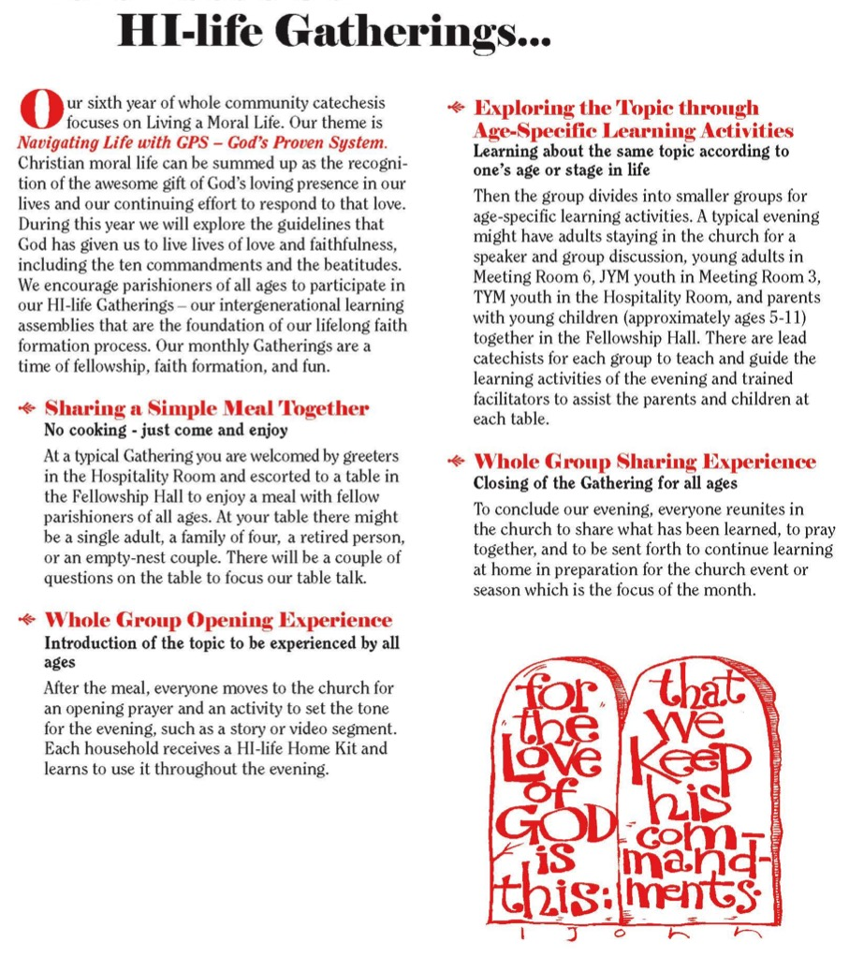

Slide 30
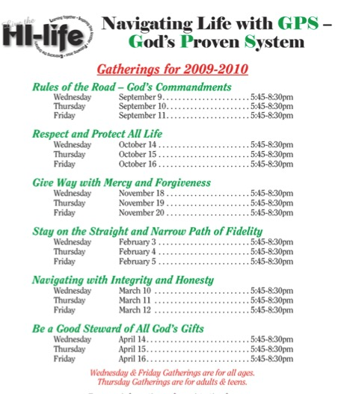
Thematic
Holy Infant Catholic Parish, Durham, NC

Slide 31
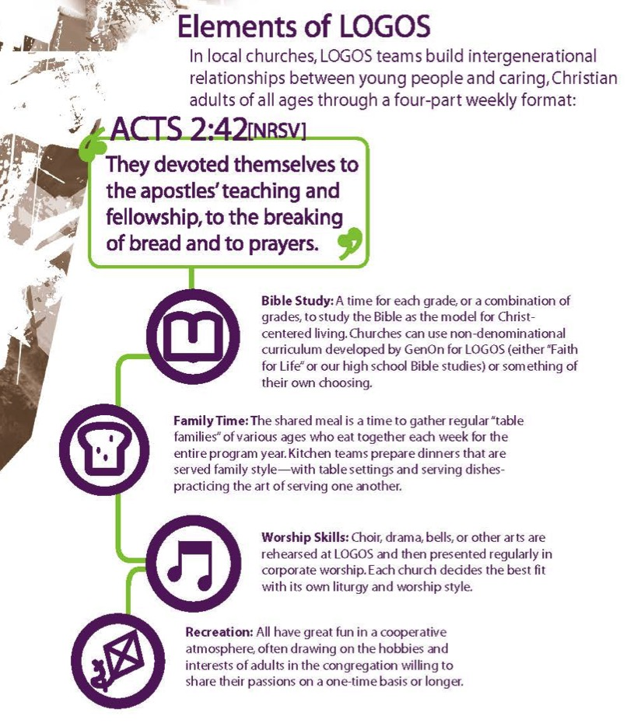
Elements of LOGOS
Bible Study
Family Time
Worship Skills
Recreation
GenOn Ministries
www.genonministries.org

Slide 32
Christian Practices
  Caring for the Body
  Celebrating Life
  Discernment
  Dying Well
  Eating Well
  Forgiving
  Hospitality
  Keeping Sabbath
  Managing Household Life
  Participating in Community
  Praying
  Reading the Bible
  Transforming the World.

Slide 33
Intergenerational Learning Process
Meal and Community Building
Part 1. Gathering and Prayer
Part 2. All Ages Learning Experience
Part 3. In-Depth Learning Experience
    Option 1. Whole Group (together)
    Option 2. Age Group (parallel)
    Option 3. Activity Center
Part 4. Sharing Learning Experiences and
Home Application
Part 5. Closing Prayer

Slide 34
Examples of IG Learning
As the faith formation curriculum for the whole community
In Lectionary-based catechesis
In sacramental preparation
In vacation Bible school
In milestone celebrations
In intergenerational service projects
In liturgical season celebrations
In an intergenerational retreat experience or prayer experience

Slide 35

Intergenerational Learning
A flexible, relaxed arrival time with drinks and snacks
Creative exploration of a Bible story/theme through creative experiences for people of different learning styles and of all ages. Children and adults are not separated and are encouraged to explore the story/theme together
A short but explicit time of worship with story, music and prayers that builds on the creative exploration.
A generous welcome and hospitality is expressed through a delicious home-cooked, sit-down meal with others

Slide 36
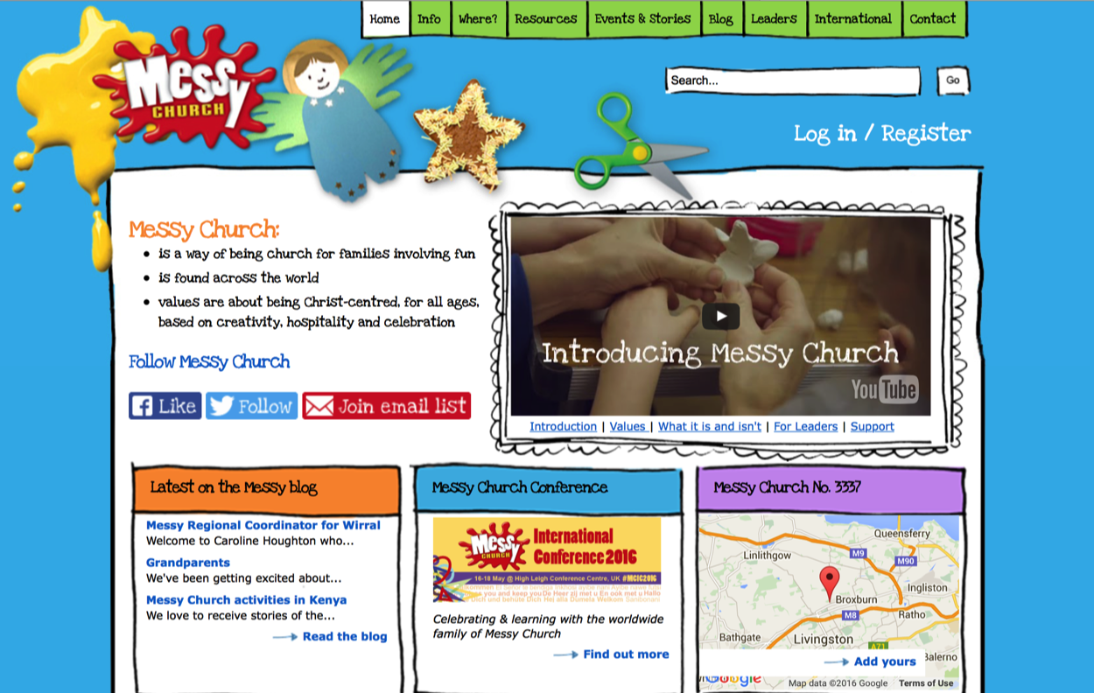
www.messychurch.org.uk

Slide 37
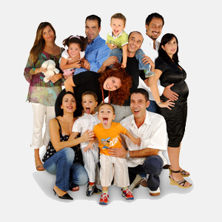
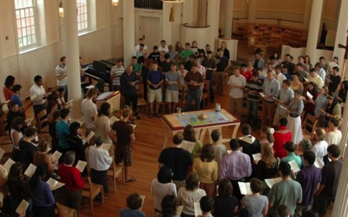
Forming Faith: Family
Primary Influence on transmission of religious faith and practice: Parents & Family
Day-to-day religious practices of the family and the ways parents model their faith and share it in conversation, collaboration, and exposure to outside religious opportunities
Secondary Influence: The Congregation and Significant Adults

Slide 38
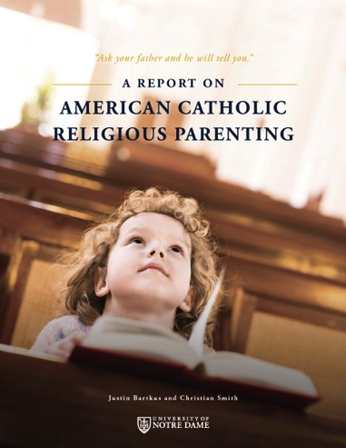
What Makes a Difference?
The primary mechanisms by which Catholic identity becomes rooted in children’s lives are not Catholic schooling or sacramental preparation, but rather the day-to-day religious practices of the family and the ways parents model their faith and share it in conversation, collaboration, and exposure to outside religious opportunities.
(Burtkus and Smith)

Slide 39
One of the most basic suggestions of our findings is that young adults arrive at a sense of their fundamental identity and worldview not by weighing all possible intellectual arguments for and against a proposed way of life, but rather by roughly adopting the worldview of those mentors who left the deepest impression upon them—and who loved them and cared for them the most. It should come as no surprise, then, that the emergence of the new generation of dedicated young Catholics will rise and fall with the choices of their parents.
(American Catholic Religious Parenting, Burtkus and Smith)

Slide 40
Practices that Make a Difference
Reading the Bible as a family and encouraging young people to read the Bible regularly
Praying together as a family and encouraging young people to pray personally
Serving people in need as a family and supporting service activities by young people
Participating regularly in Sunday worship as a family
Being involved in a faith community and serving in church as a family and as young people
Eating together as a family
Celebrating rituals and holidays at home
Having family conversations
Talking about faith, religious issues, and questions and doubts
Ritualizing important family moments and milestone experiences
Celebrating holidays and church year seasons at home
Providing moral instruction

Slide 41
Parental Influence
Parent Role
Sponsor of the Faith
point of access between church home
Gatekeeper of the Faith
control over how much and what sorts of religious content their children encounter
Interpreter of the Faith
meaningful embodiment of the Christian faith in the lives of children

Slide 42
Comprehensive Family Plan
Children/Teens + Parents + Grandparents
Family Faith
at Home
Family Engagement in the Intergenerational Faith Community
Family Life
& Parent Formation
Three Elements of a Family Plan

Slide 43
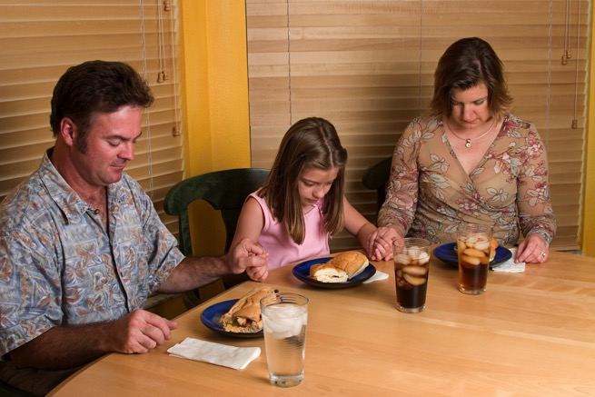
#1. Faith Practices @ Home
Seasons of the year
Rituals and milestones
Learning the tradition
Prayer and spiritual
formation
Reading the Bible
Service, justice, care for creation
Young Children
Older Children
Young Adolescents
Older Adolescents

Slide 44
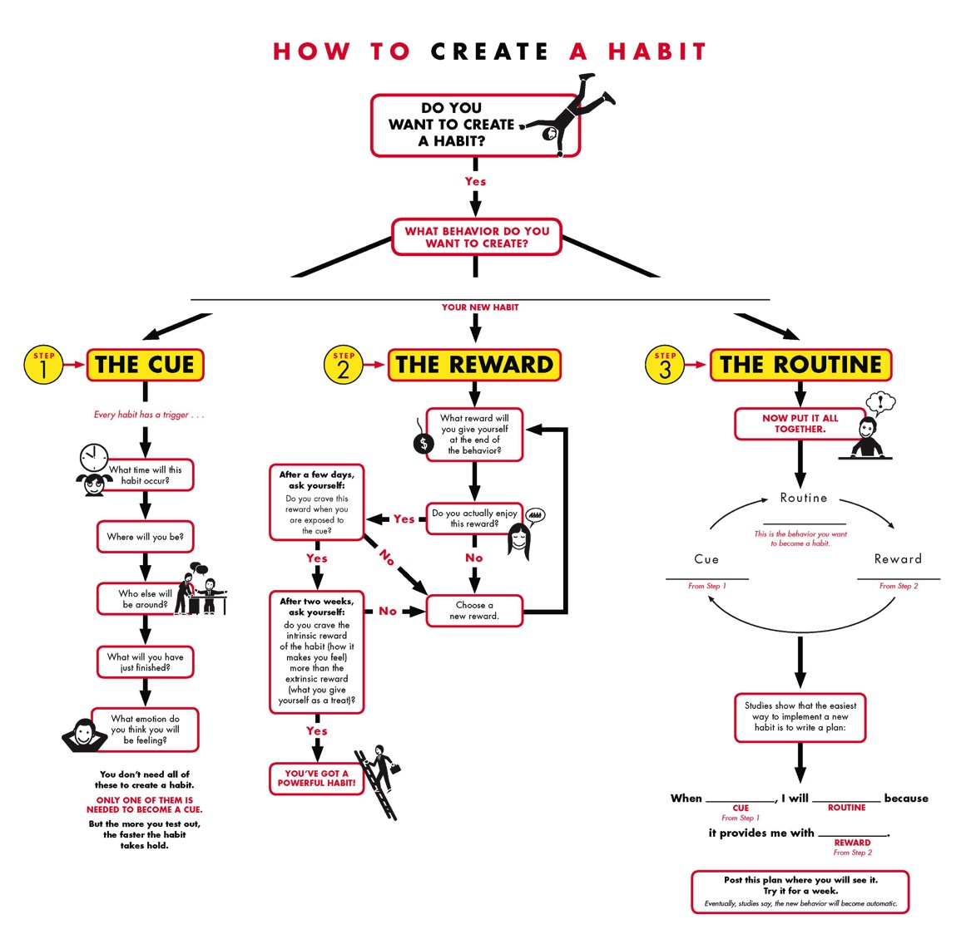

Slide 45
How to Create a Habit
1
The Cue
3
The Routine
2
The Reward
When _(cue)_, I will _(routine)_ because it provides me with __(reward)__.

Slide 46
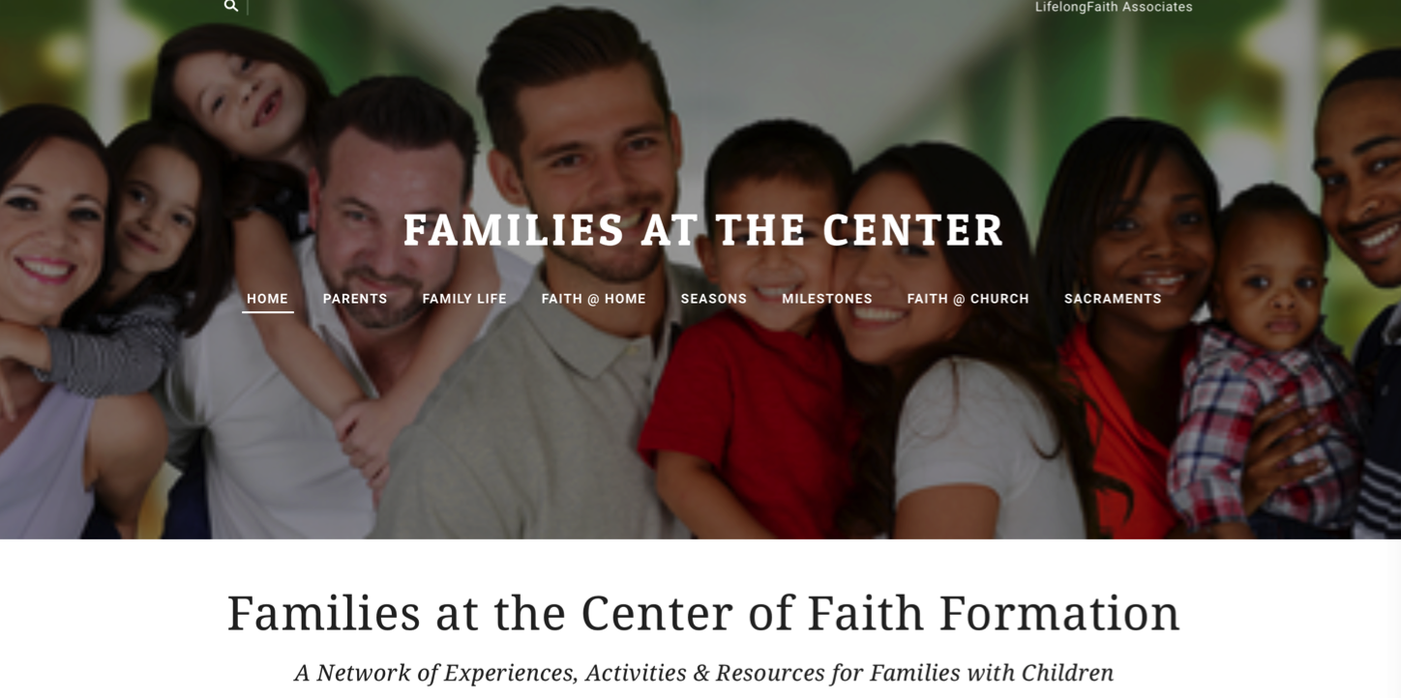

Slide 47
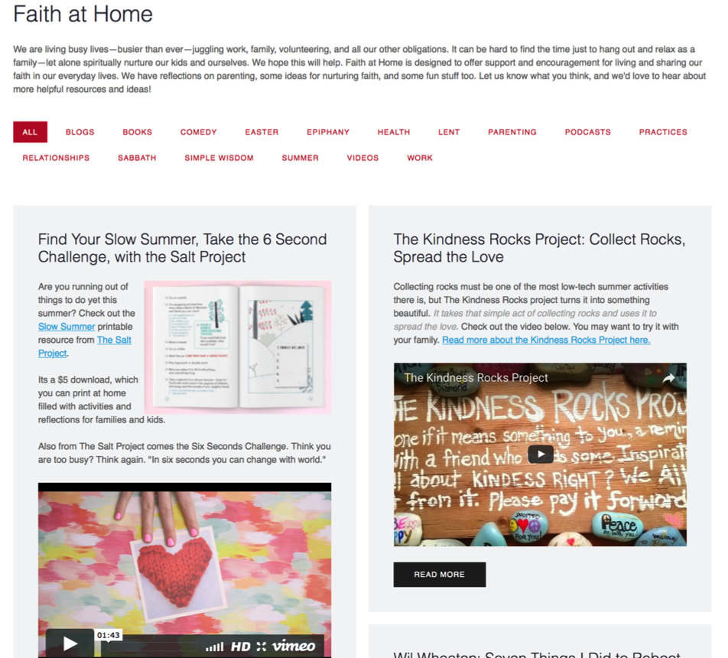

Slide 48
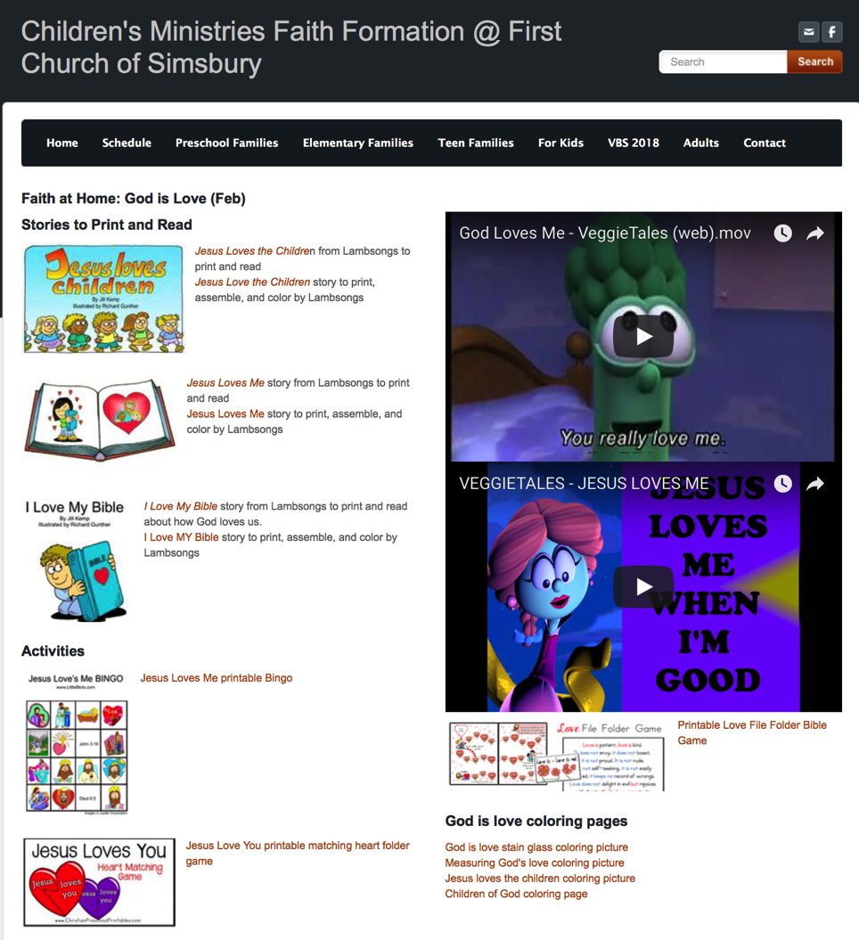

Slide 49

#2. Milestones throughout Life
Ritual and blessing
Home celebration/blessing
Learning program –
Symbol
Supporting continued growth

Slide 50
Milestones
  Birth / Baptism
  Baptism anniversaries
  First prayers
  First Bible stories
  Starting school year
  Receiving a first Bible
  First Communion
  Confirmation
  Graduation
Church ritual/blessing
Home celebration/blessing
Learning program – at church or home
Symbol
Supporting continued growth

Slide 51
Forming Faith through Milestones
a ritual celebration or a blessing marking the milestone with the whole church community
a home ritual celebration or blessing marking the milestone
a learning program, often for the whole family or intergenerational, that prepares the individual and the whole family for the milestone and for faith practice at home
a tangible, visible reminder or symbol of the occasion being marked
resources to support continuing faith growth and practice after the milestone

Slide 52
Forming Faith through Milestones
Preparing
Experiencing
Living
How will you sustain/extend the event?
How will you design the event?
What types of experiences, programming, activities, and resources will you develop to prepare people for the event?
How will you engage age groups, families, and the faith community?
What types of experiences, programs, activities, and resources will you offer people?

Slide 53
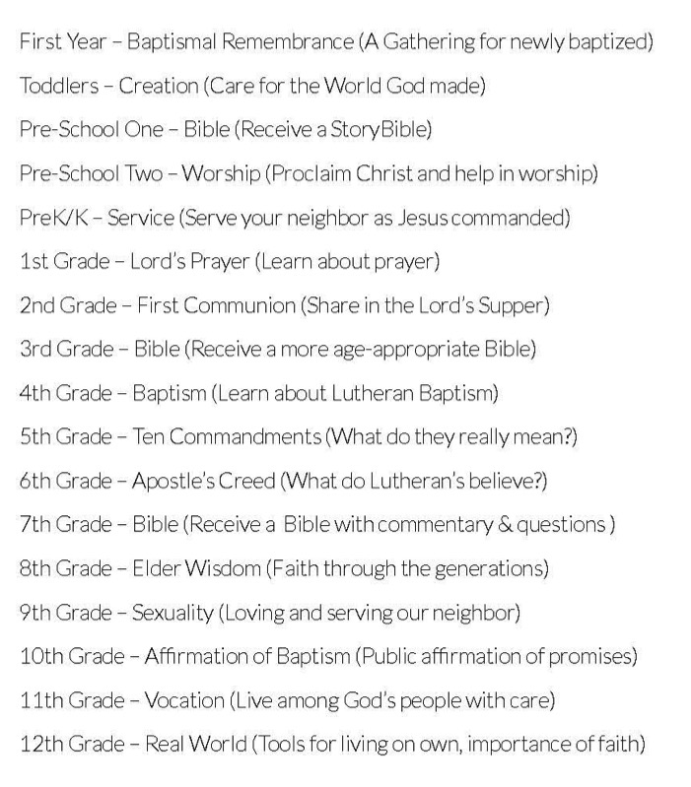

Forming Faith through Milestones

Slide 54
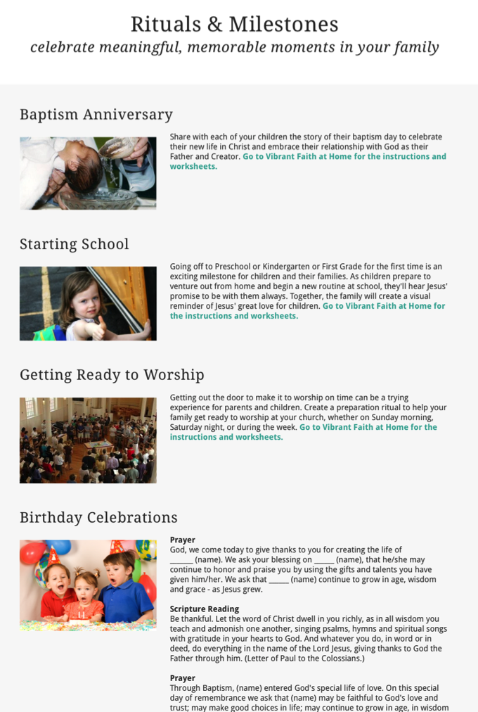

Slide 55

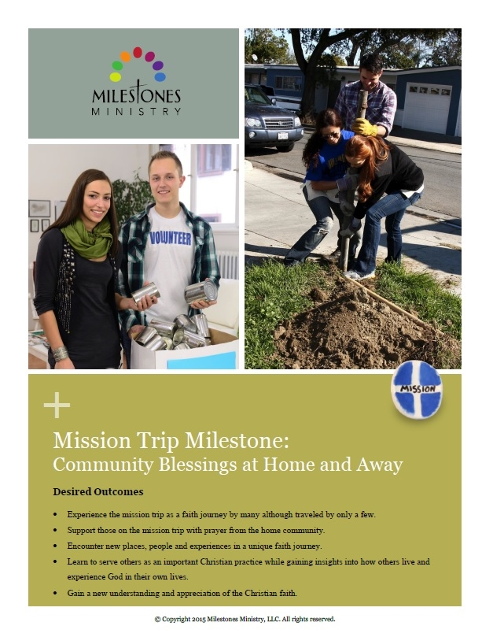
Forming Faith through Milestones

Slide 56
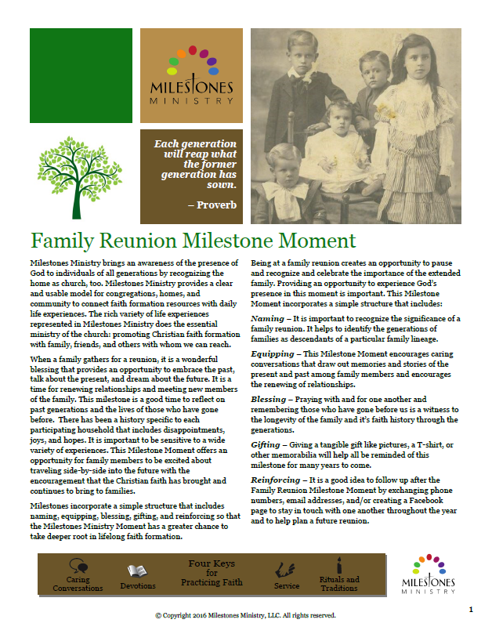

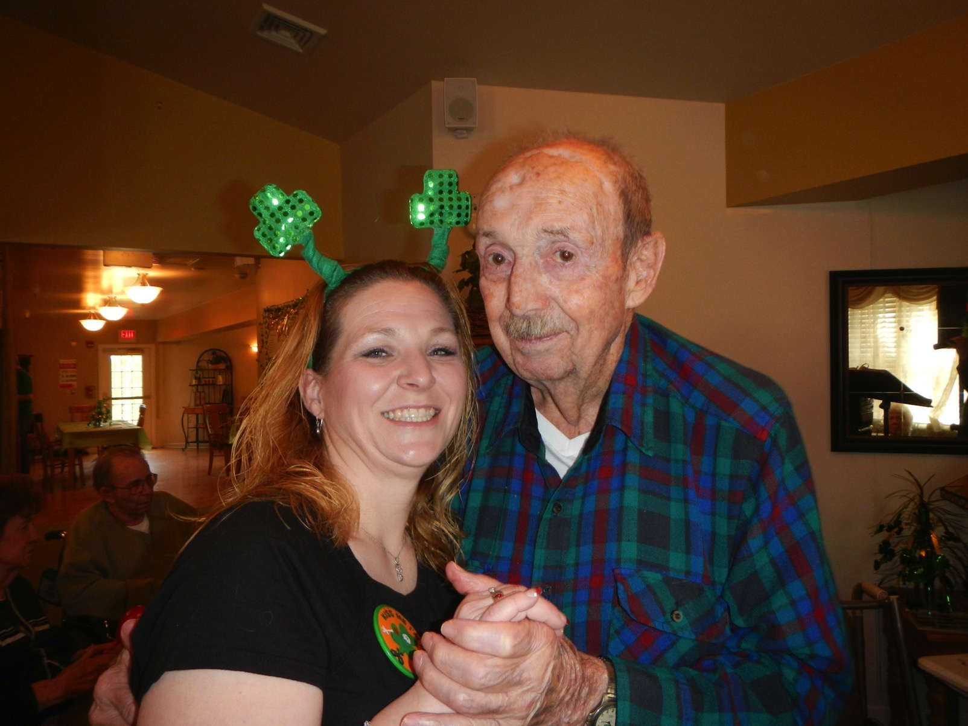
Forming Faith through Milestones

Slide 57
#3. Celebrating Seasons
Calendar Year
Church Year
New Year’s Eve and Day
Martin Luther King Jr. Day
Valentine’s Day
St. Patrick’s Day
Earth Day
Mother’s Day
Memorial Day
Father’s Day
July 4 – Independence Day
Labor Day
Start of School
Halloween
Thanksgiving
Advent
Christmas
Epiphany
Ash Wednesday
Lent
Holy Week
Easter
Pentecost
St. Francis Day–Blessing the Animals (October 4)
All Saints and Souls (Nov 1-2)

Slide 58
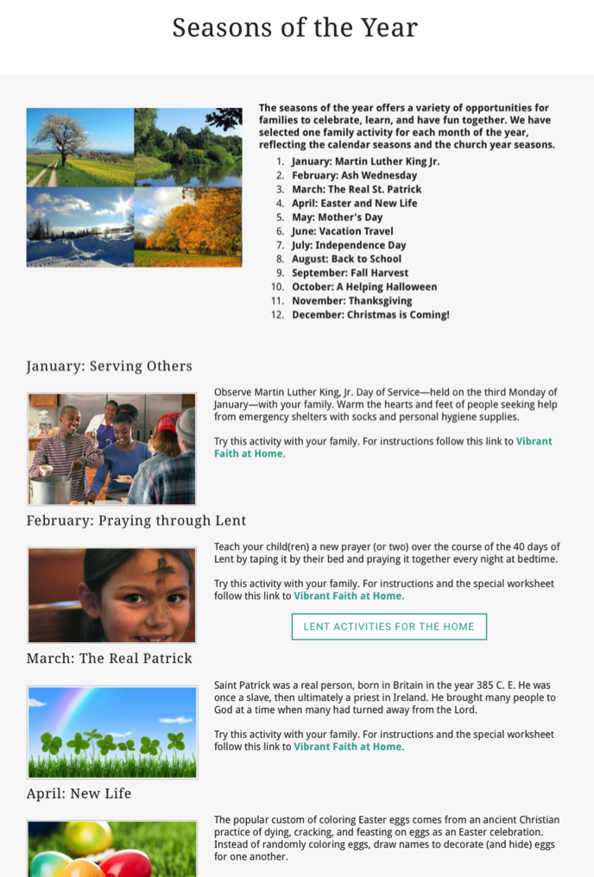

Slide 59
Integrate Online & Gathered
40-Day Lent Curriculum
Church ➔ | Daily & Home | ⬅ Online
Ash Wednesday Lenten Sunday liturgies Stations of the Cross Lenten prayer Lenten retreat Lenten service Lenten soup suppers | Fasting Praying Service/Almsgiving Lectionary reflection Family Lenten activities | Lenten learning resources Lenten calendar Daily Lenten prayer Weekly table prayer Video resources Online retreat experience

Slide 60
Example: Earth Day
Community | Church | Home
Community cleanup Planting a community garden All ages workshop on caring for creation Story time at the library on environmental awareness | Ecumenical prayer service Intergenerational program on theology of caring for creation Church audit Global project for whole community | Recycling activities Planting a family garden Meal time creation prayer Daily Bible verses for April Children’s activities Storybooks and videos Home audit

Slide 61
#4. Encountering God in the Bible
Scripture in Sunday Worship
      Lectionary
      Sermon Series
Exploring the Bible—Family or Intergenerational Programs
    A Tour of the Old Testament
    A Tour of the Gospels
    Walking with Jesus
    Journeys of Paul

Slide 62
Encountering God in the Bible
Scripture in Sunday Worship
Intergenerational & Home Faith Formation
September: 24th Sunday in Ordinary Time
October: 28th Sunday in Ordinary Time
November: 32nd Sunday in Ordinary Time
December: 2nd Sunday of Advent
January: Baptism of the Lord Sunday
February: 1st Sunday of Lent
March: Palm Sunday
April: 4th Sunday of Easter
May: Holy Trinity Sunday

Slide 63
Extend the Event
Church Event or Program
At Home & Daily Life

Slide 64
Practical Strategies
Develop a family faith formation website.
Seasonal family festivals and gatherings.
Connect to Sunday worship.
Schedule a yearlong plan for milestones.
Make faith practices a seasonal focus.
Create family immersion experiences.
Develop a monthly seasonal event.

Slide 65
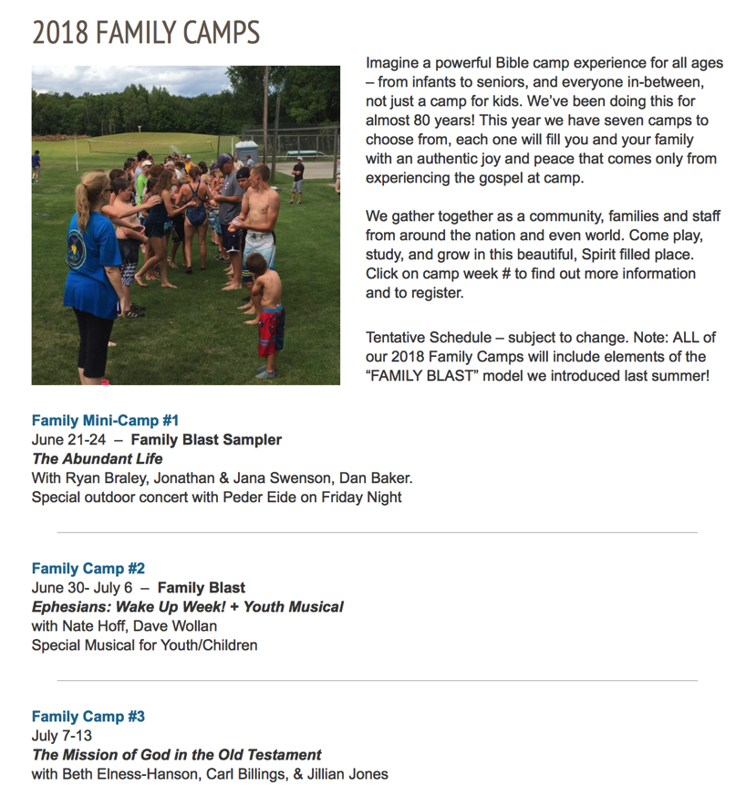

Family Camp

Slide 66

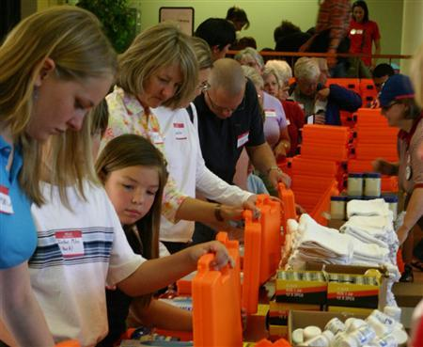
Family Service

Slide 67
#5. Equipping Parents
Equipping parents and grandparents with the knowledge and skills necessary for faith-forming: how to transmit faith and values to their young people, how to become a Christian role model, and how to build a community of faith at home that nurtures faith growth in the young.

Slide 68
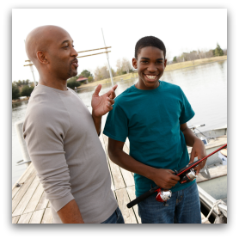

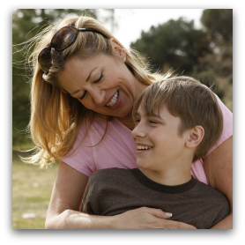


Developing a Strong Family Life
Developmental Relationships – Search Institute
Express Care
Challenge Growth
Provide Support
Share Power
Expand Possibilities

Slide 69
What Makes a Difference
Parents participated in mission trips.
Parents participated in service projects.
Parents frequently shared Christ with unbelievers.
Parents personally read the Bible several times a week or more.
Parents encouraged their teen to serve in the church.
Parents typically asked for forgiveness when they messed up.
Parents encouraged their children’s unique talents and interests.
Parents attended churches that emphasized what the Bible says.
Parents taught their children to tithe.

Slide 70
Developing Strong Family Life
Family Life Programming
Communicating effectively
Establishing family routines: family meals, shared activities, daily commitments
Celebrating meaningful traditions and rituals
Discussing tough topics
Making decisions and solving problems as a family
Learning how to build strong relationships and express care for each other
Developing the strengths & potential of children & youth
Supporting each other: encouraging and praising, giving feedback, standing up for each other
Treating each with respect and dignity

Slide 71
Empowering Parents
Competencies
Expressing care, love, affection, and support for children
Balancing time and commitments, managing stress
Practicing healthy relationships
Disciplining children and learning discipline practices
Creating a warm, caring supportive family.
Set boundaries and high expectations for children
Managing technology and media use
Challenging children to grow and continuously improve
Providing support to help children complete tasks and achieve goals
Sharing power with children so that there voice is heard and they share in making decisions.
Expanding possibilities and connecting children to opportunities for growth
Developing emotional communication skills
Developing positive parent-child interaction skills
Learning to respond consistently to their child

Slide 72
Three Parental Faith Roles
Parent Role
Sponsor of the Faith
point of access between church home
Gatekeeper of the Faith
control over how much and what sorts of religious content their children encounter
Interpreter of the Faith
meaningful embodiment of the Christian faith in the lives of children

Slide 73
Empowering Parents
Key Content
Faith Forming Skills & Practices
Parental Faith Formation
Knowledge & Skills for Parenting

Slide 74
Parent Programming
Parent website
Parent programs
  Progression of parent workshops, webinars, or courses through the life cycle
  Incorporate parent formation and education into congregational events that already engage parents
  Provide targeted programs of theological and biblical formation
  Add a parent-only component to family-intergenerational learning programs
  Add a parallel parent experience to the existing children/teen program
  Add a parent component to vacation Bible school in the evenings or online.
  Provide online faith formation for parents
Laboratory experiences
Parent mentors
Life cycle or affinity groups for parents

Slide 75
Suggestions for Programming
Address diverse spiritual-religious identities of parents.
Have parents practice new skills with their own children during program sessions.
Design programs that engage parents in the learning experience.
Use a variety of environments and methods to engage all parents, anytime and anywhere.
Use online platforms and digitally enabled strategies.
Give parents a plan.

Slide 76
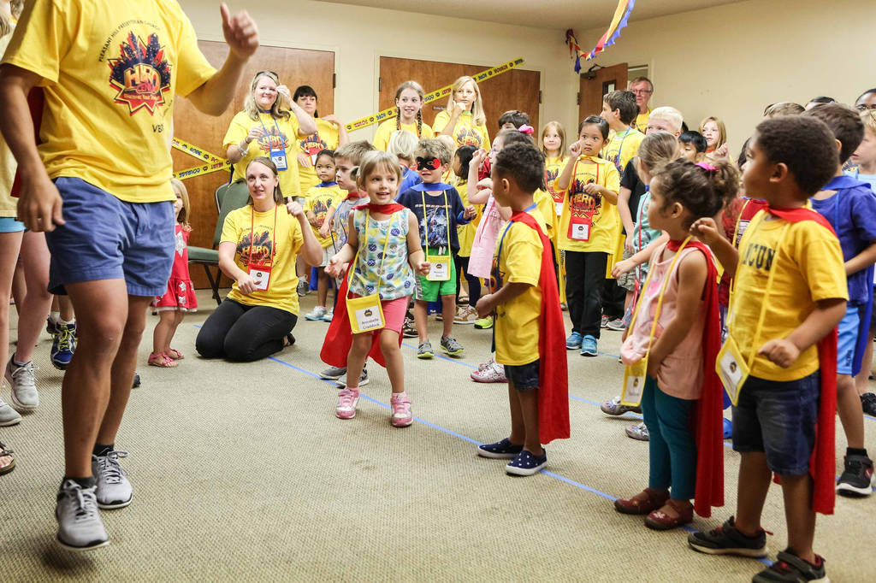
Forming Faith: Children

Slide 77
Characteristics of 21st Century Learning
Blended Learning
Micro-Learning
Immersive Learning Environments
Multiple Ways of Learning
Multisensory Learning
Project-Based Learning
Collaborative Learning
Visual Learning
Practice-Oriented Learning
Storytelling

Slide 78
Developing a Faith Formation Plan
Faith Maturing Characteristic | Children | Youth | Young Adults | Adults | Family
 | Intergen-erational | Intergen-erational | Intergen-erational | Intergen-erational | Intergen-erational
1.
 | Family | Family | Family | Family | Family
2.
 | Age Group | Age Group | Age Group | Age Group | Age Group
3.

Slide 79
Two Ways to Approach Personalizing
Approach One: Personalize the Pathway for People
Develop pathways of faith maturing
Develop playlists of content and experiences tailored to the pathways
Upload playlists to a digital platform
Approach Two: Personalize the Offerings
Offer a variety of content, experiences, and activities tailored to different spiritual-religious identities and the life stage needs of people
Getting Started ---- Growing ---- Going Deeper
Format the content tailored to different spiritual-religious identities
Develop a digital platform with content to address the needs

Slide 80
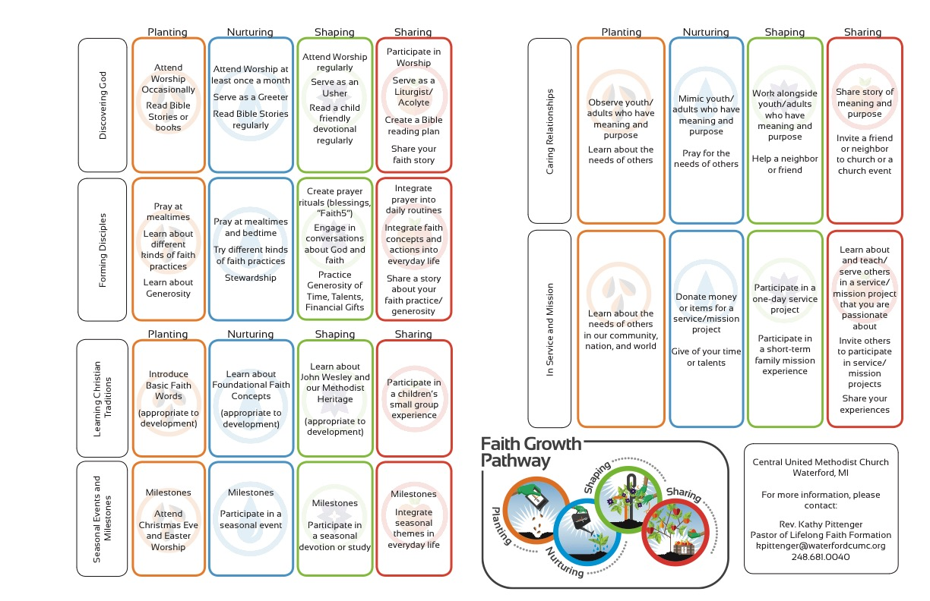

Slide 81
Diverse Spiritual-Religious Needs
Not Spiritual, Not Religious
Unaffiliateds
The
Spiritual but Not Religious
Uninvolved
Faith & Engagement – one among many priorities
Occasionals
Faith & Engagement at the Center of Life
Actives

Slide 82
Personalized Pathways of Faith Growth
Pathways
PATHWAY
Variety of Experiences & Activities
Occasional
Variety of Experiences & Activities
Uninvolved
Unaffiliated
Variety of Experiences & Activities
Vibrant
PLAYLIST

Slide 83
Personalized Pathways of Faith Growth
Characteristic
Inquiring
Playlist of Experiences & Activities
Getting
Started
Playlist of Experiences & Activities
Growing
Playlist of Experiences & Activities
Going
Deeper
Playlist of Experiences & Activities

Slide 84
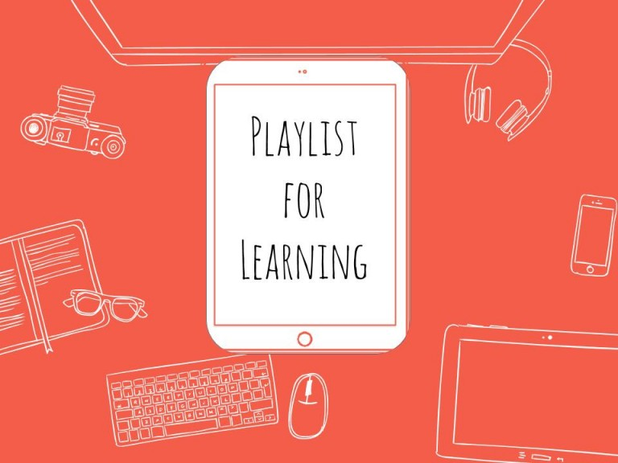
Playlists for Faith Formation

Slide 85
Playlists of Content & Experiences
If you were to use a Playlist approach to develop the faith of families with young children….
      Getting Started Families (little faith experience)
      Growing Families (somewhat connected to faith community)
      Going Deeper Families (involved and practicing)
  How would you engage the parents?
  How would you engage the children and whole family?

Slide 86
Playlists of Content & Experiences
If you were to use a Playlist approach for first communion…
      Getting Started Children (little to no faith forming experiences)
      Growing Children (some faith forming experiences)
      Going Deeper Children (involved and practicing)
  What would faith formation look like with these three “types” of children?
  What would parent and family faith formation look like?

Slide 87
Faith Formation Playlists
A faith formation playlist is a curated group of digital (online, video, audio, print) and gathered (church, home, small groups, etc.) faith forming experiences and resources that are tailored to the specific faith growth needs of people around a particular characteristic of faith maturing or theme/topic.
Playlists are developed for each “stage” on the discernment continuum, such as Inquiring, Getting Started, Growing, Going Deeper.
Each playlist provides a variety of ways for people to learn and grow in faith.

Slide 88
Personalize the Offerings
Playlists Tailored to Different Faith Needs
Playlist:
Reading & Studying the Bible
Getting Started
  Participate in the “Welcome to the Bible” program at church
  Watch the video programs on how to read the Bible
  Watch the video program with an overview of the Old Testament and New Testament
  Use the Guide to select a Study Bible and find the Bible online
  Participate in the 30-Day Bible Experience: Reading one Gospel (Matthew, Mark, or Luke)
Growing
  Develop a daily plan for reading the Bible
  Participate in the lectio divina reflection group after Sunday worship
  Learn how to pray with the Bible
  Join a Bible study group (church, home, coffee shop, online)
Going Deeper
  Read the Bible in 365 days
  Develop a personal Bible study plan
  Take an online course: Hebrew Scriptures, Gospels, Letters of Paul
  Study and pray the Psalms as a spiritual practice

Slide 90
Projects
Adolescence
Multigenerational and families
Baptism parents and children
Birth to five
Young parents and children to age 5-6
Confirmation – parents and teens
Parents of school age children – Catholic school + public school
Evangelization + multigenerational + family
Intergenerational in conjunction with family faith formation and Christlife program
Parents and grade school children
Pre-baptism through age 5 – parents and children
Parents and children: 6 to 18
Multigenerational + families

Slide 91
Design Questions
Calendar for the parish
Strategies for making a change – making people more comfortable with change
Confirmation – post; work as leaders (digital media)
Website design
Packaged programs (small parish) that can be expanded – faith formation for the entire parish
Inviting people into leadership/ministry roles
Intergenerational programs/activities
Draw people to Mass

